Slide 1


Slide 2
Public Understanding of Science
“Making Science Fun”

Slide 3
Public Understanding of Science
Teachers constantly pushed to make science ‘fun’;
The uneasy tension between ‘education’ and ‘entertainment’;
(Perception of) hazard/liability (we manage risk, we don’t avoid it)…

Slide 4
Public Understanding of Science
But where’s the “fun” in, say, in demanding kinetic/thermodynamic calculations?
Science is a superb and dazzlingly-lit kitchen which may be reached only by passing through a long, dark and ghastly hall.
Claude Bernard (1813-1878)

Slide 5
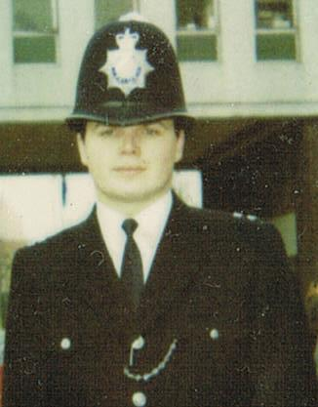
Public Understanding of Science

Slide 6
Public Understanding of Science
You can aim to provide your pupils with:
Shock, awe, surprise and delight…

Slide 7
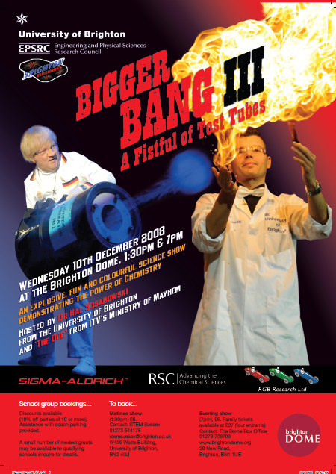

Slide 8


Slide 9


Slide 11
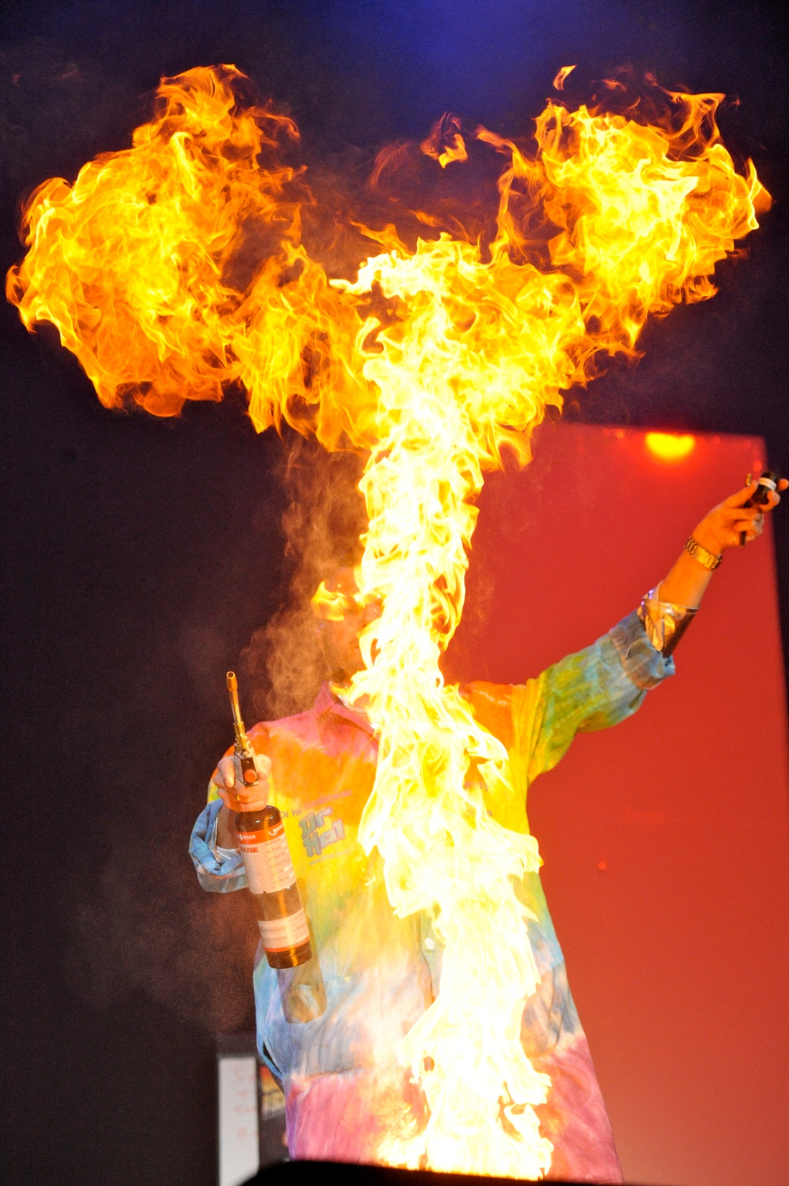
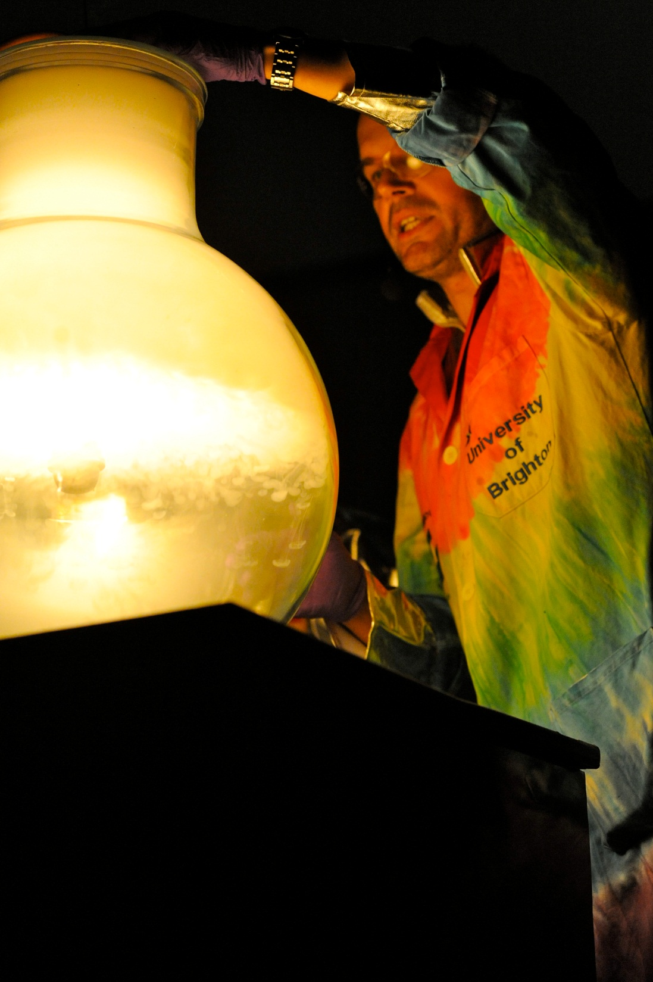

Slide 12
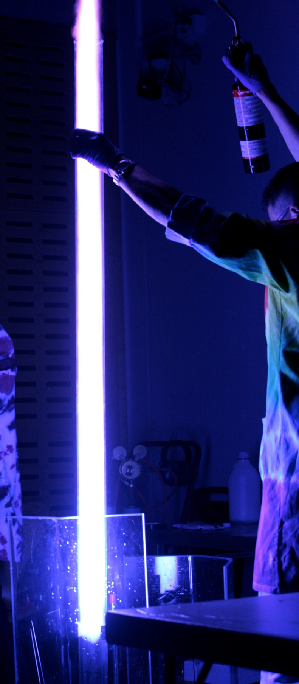
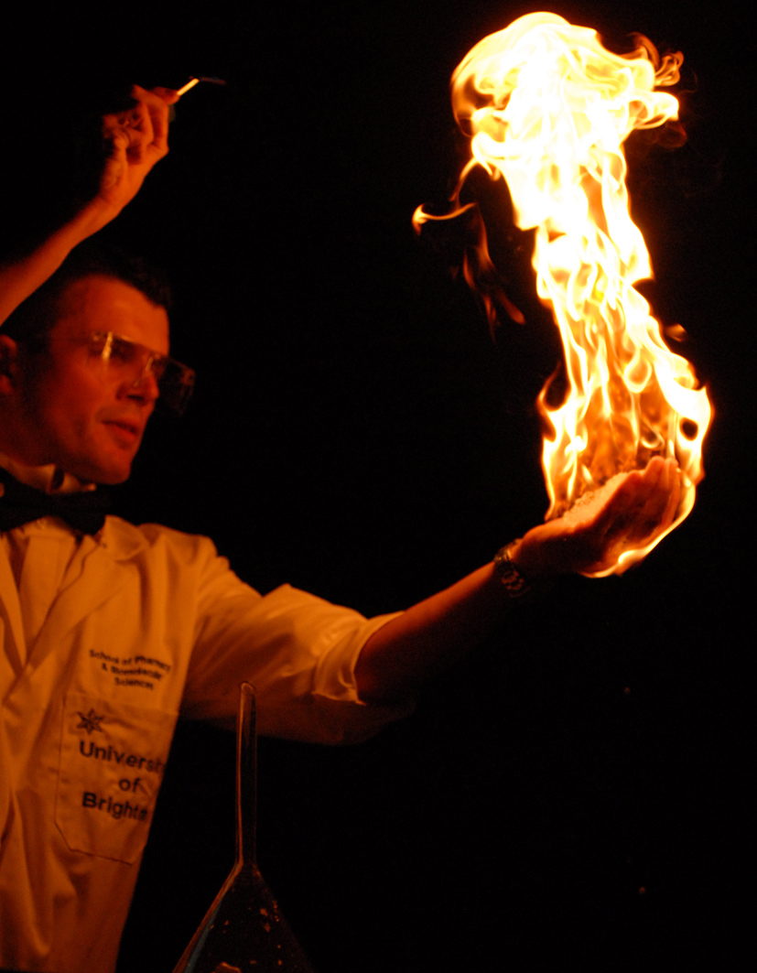

Slide 13
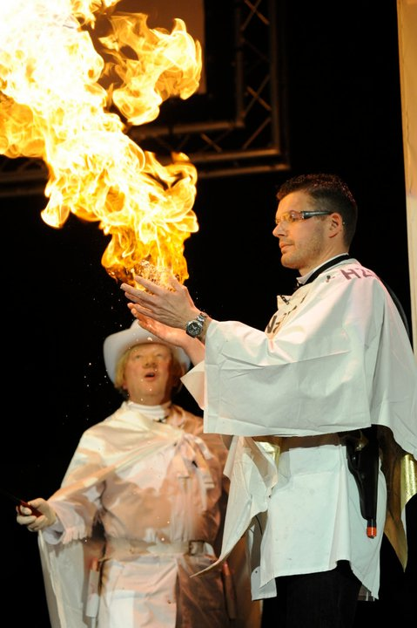
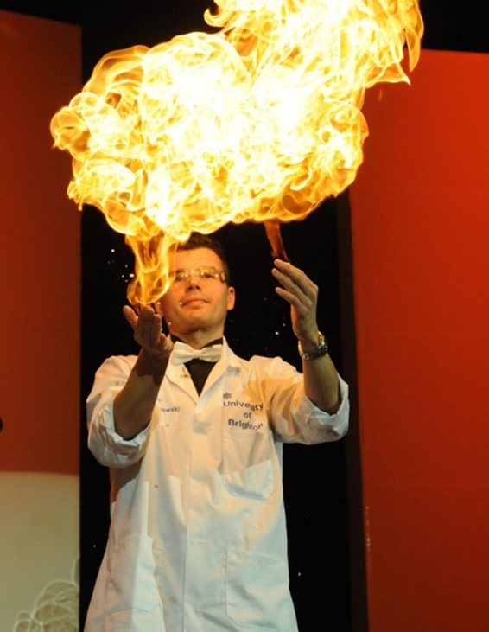

Slide 14
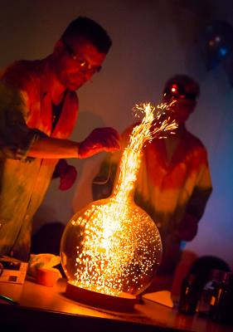
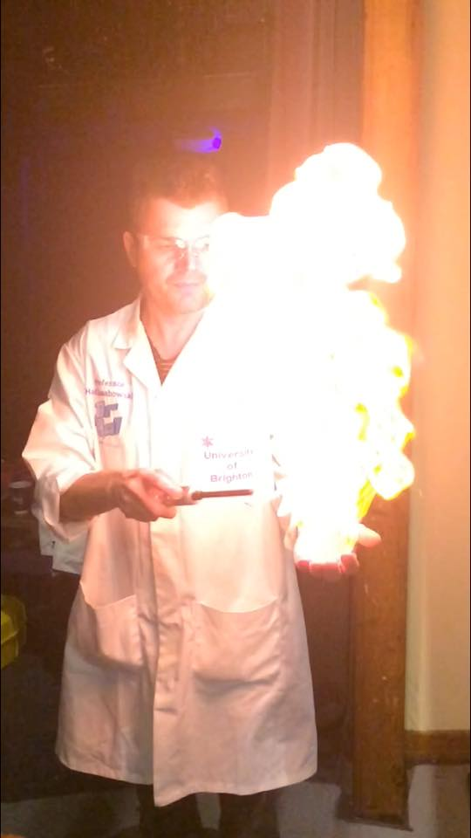

Slide 15
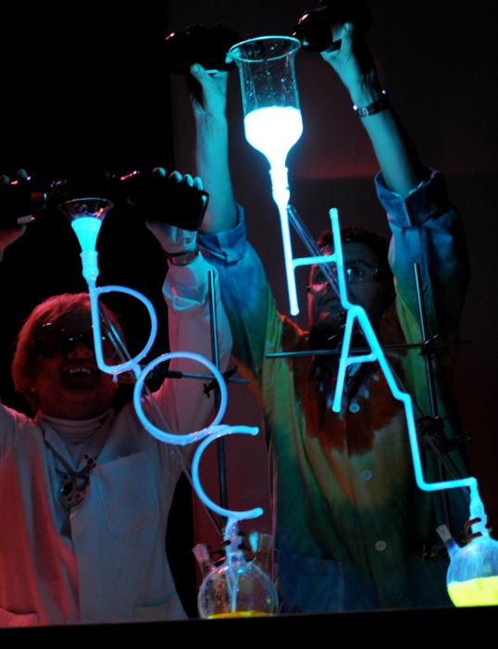
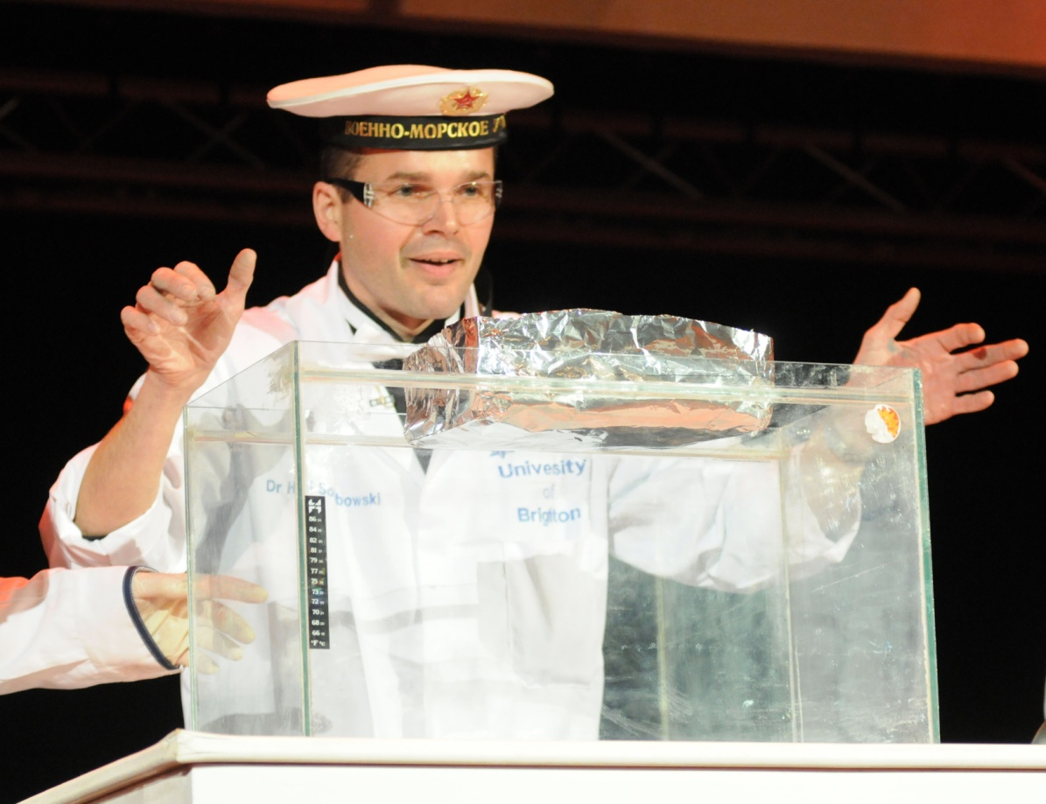


Slide 16
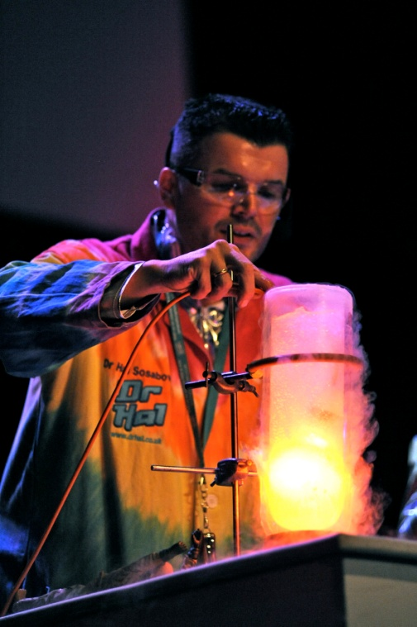
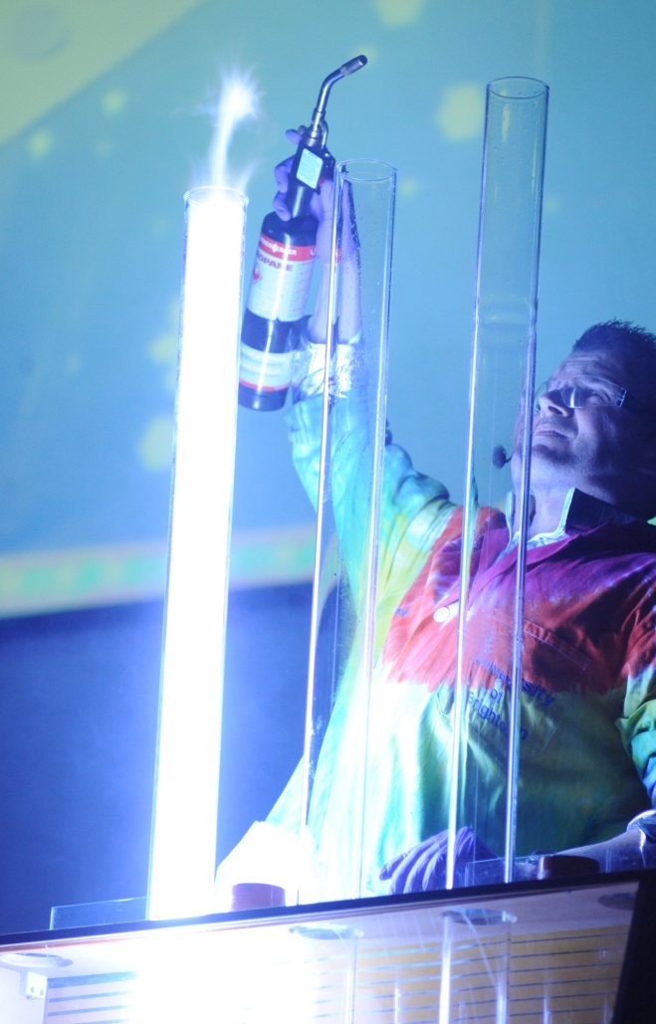

Slide 17
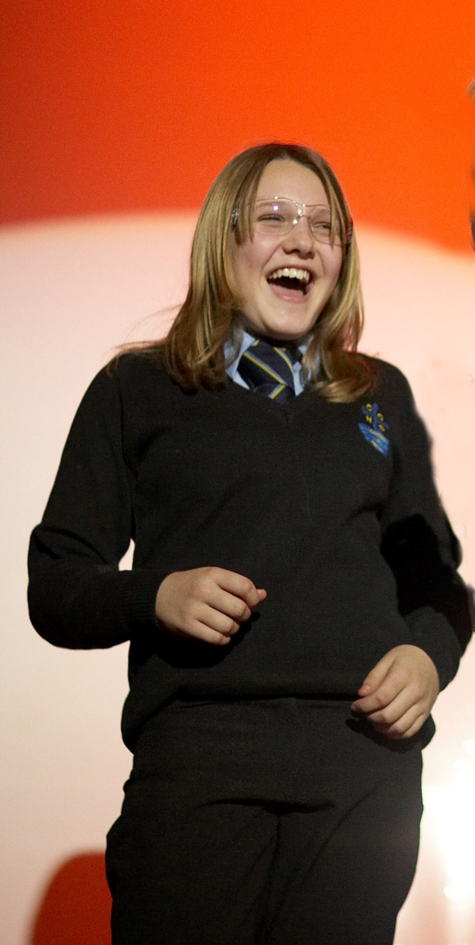
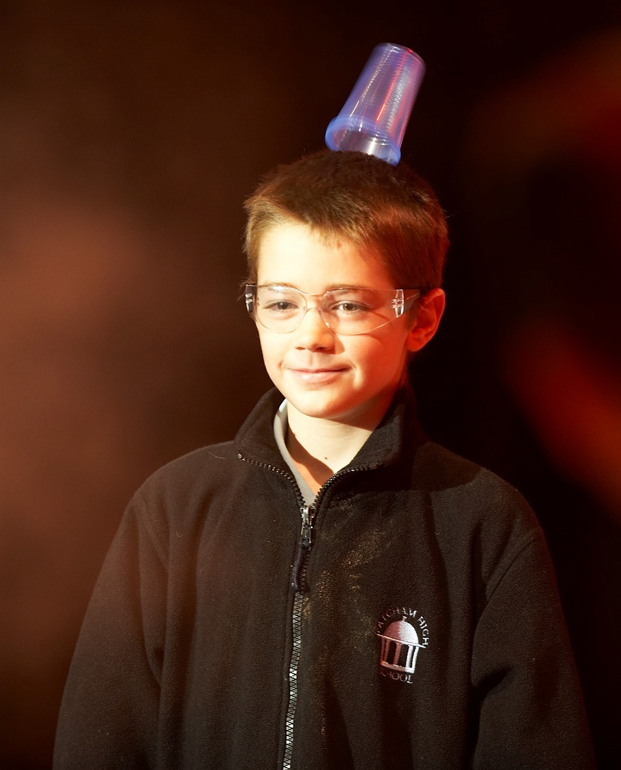

Slide 18
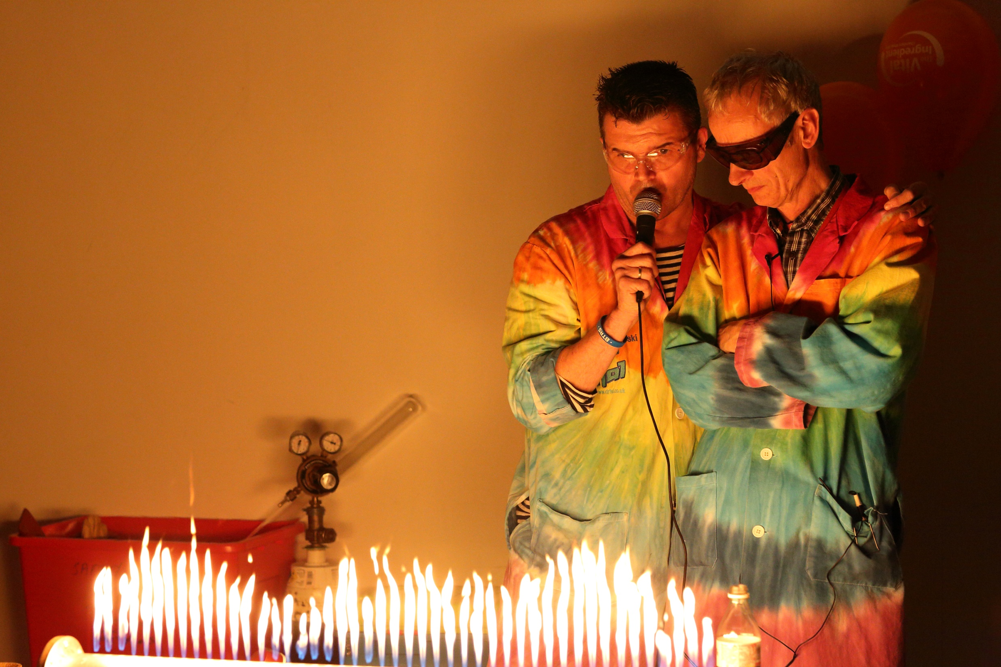
Notes:
I am normally introduced by an instructor - I then say who I am and point out that I have some service as a PC at Hammersmith (MPS)

Slide 19
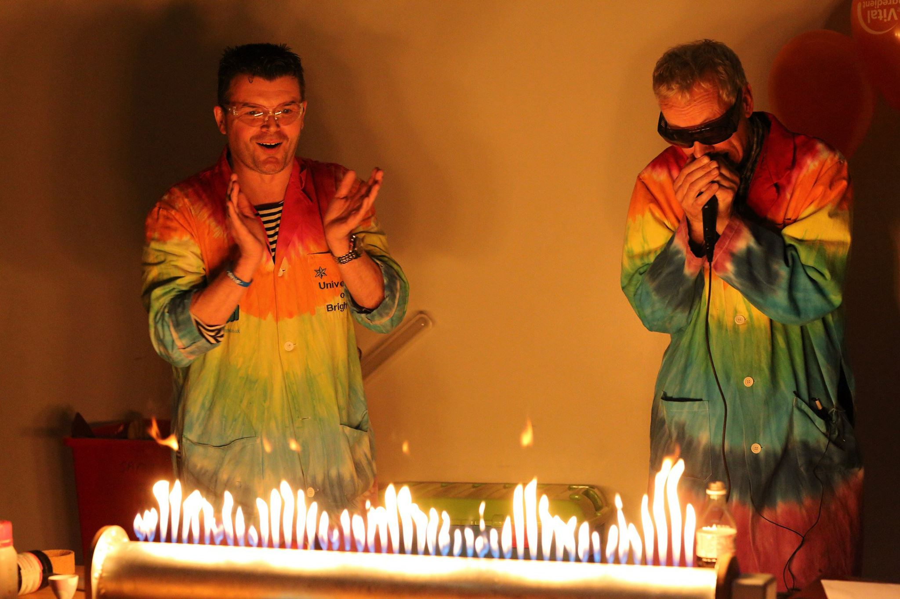
Notes:
I am normally introduced by an instructor - I then say who I am and point out that I have some service as a PC at Hammersmith (MPS)

Slide 20
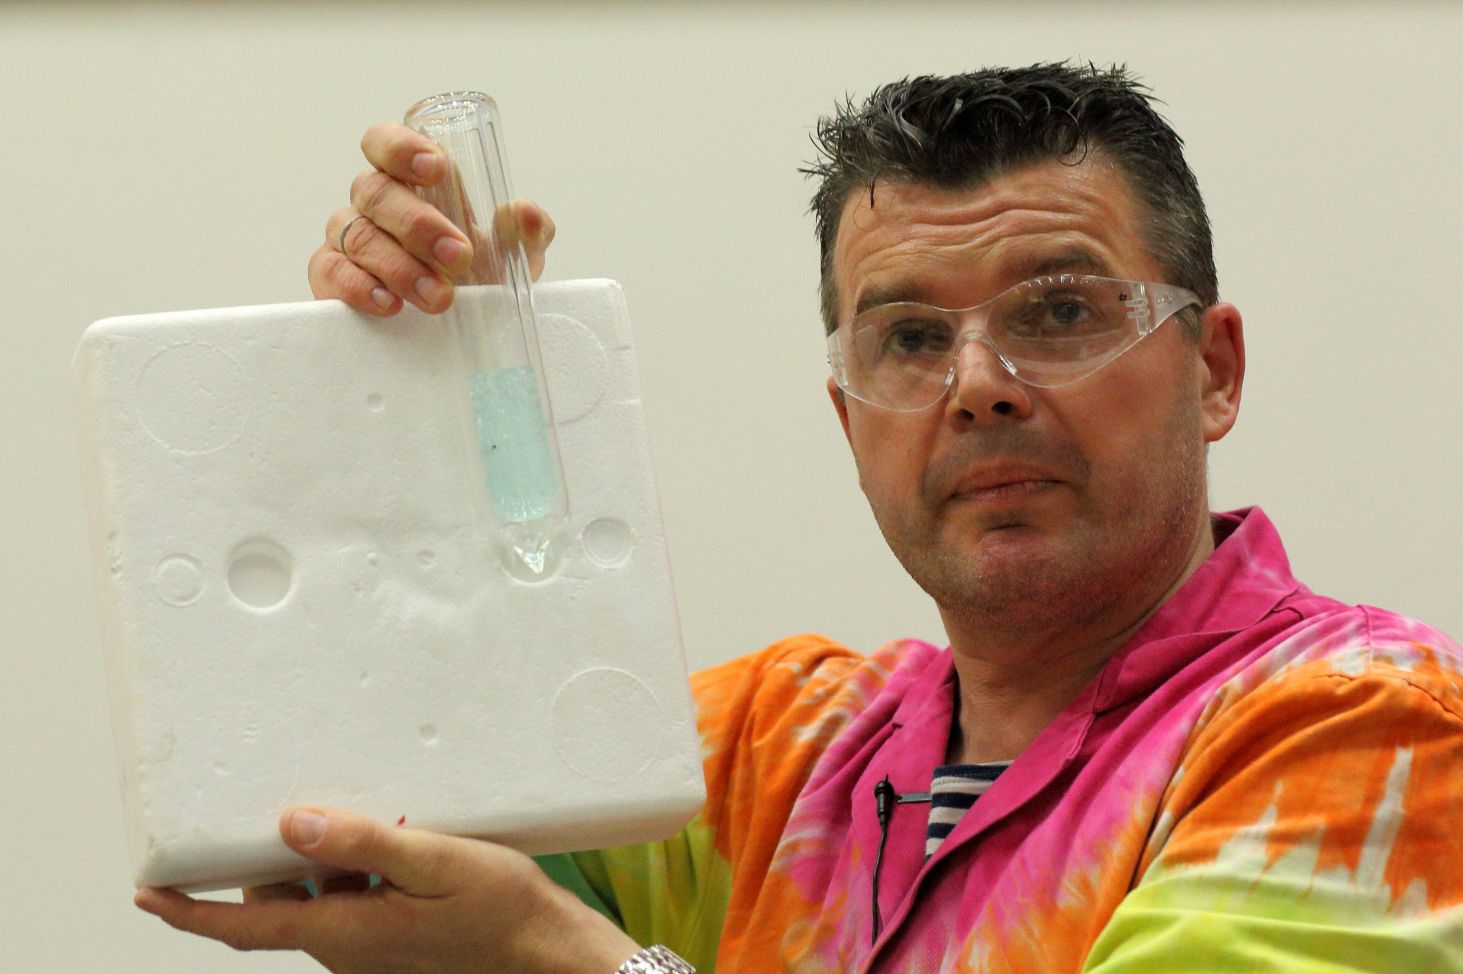
Notes:
I am normally introduced by an instructor - I then say who I am and point out that I have some service as a PC at Hammersmith (MPS)

Slide 21
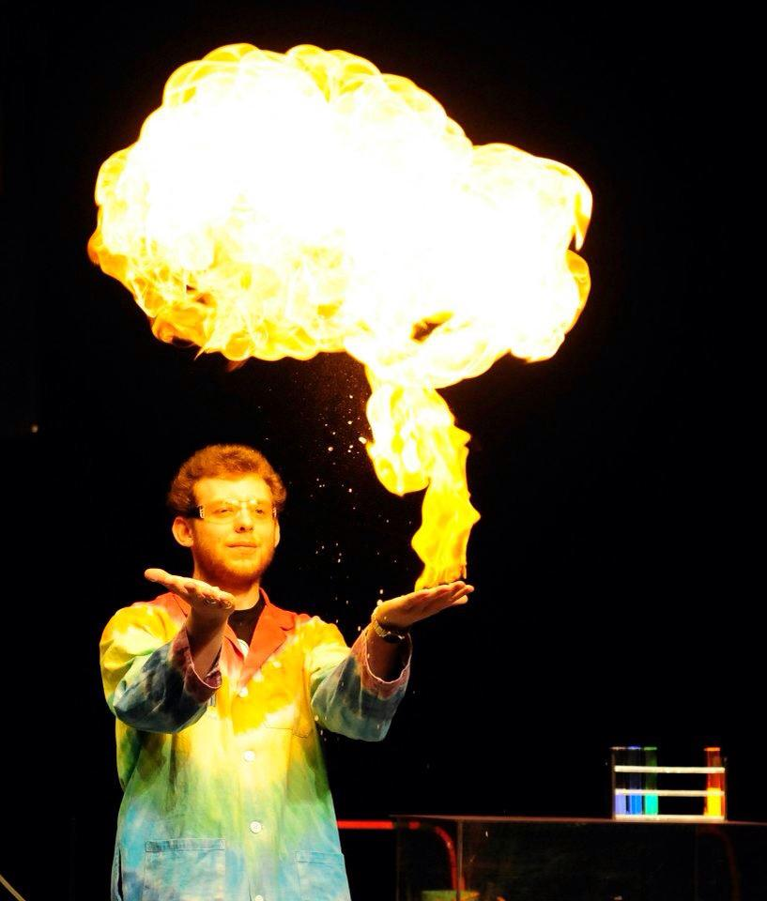

Slide 22
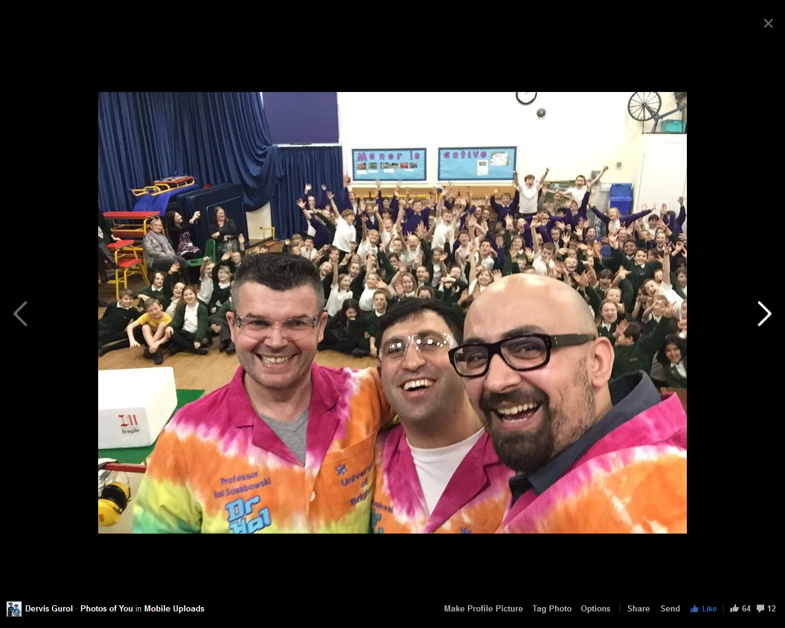
Public Understanding of Science
Science in Industry

Slide 23
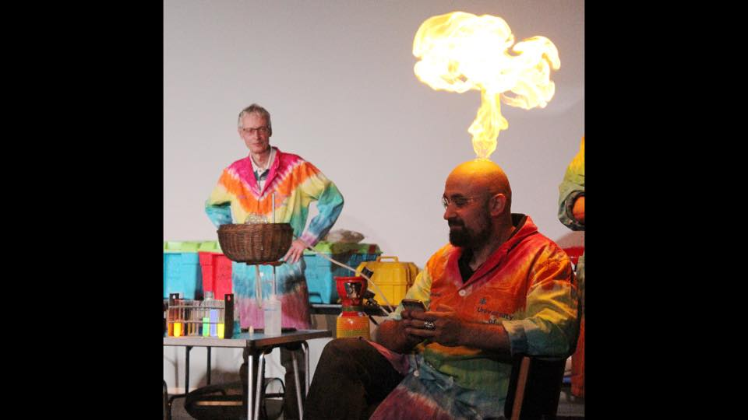

Slide 24
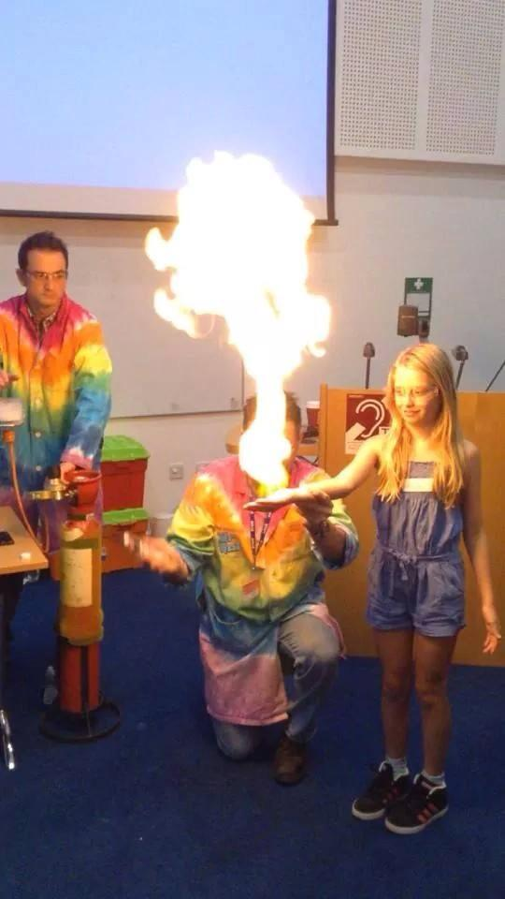
Notes:
I am normally introduced by an instructor - I then say who I am and point out that I have some service as a PC at Hammersmith (MPS)

Slide 25
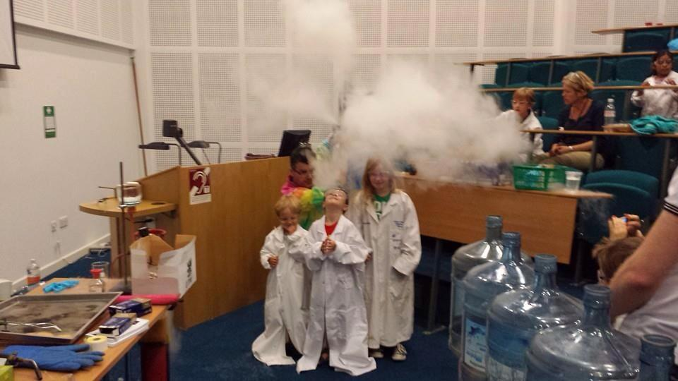
Notes:
I am normally introduced by an instructor - I then say who I am and point out that I have some service as a PC at Hammersmith (MPS)

Slide 26


Slide 27
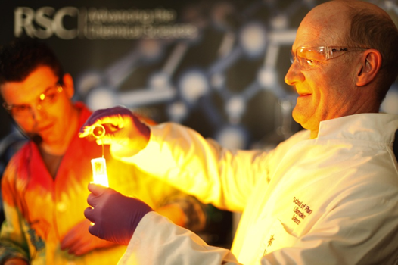

Slide 29
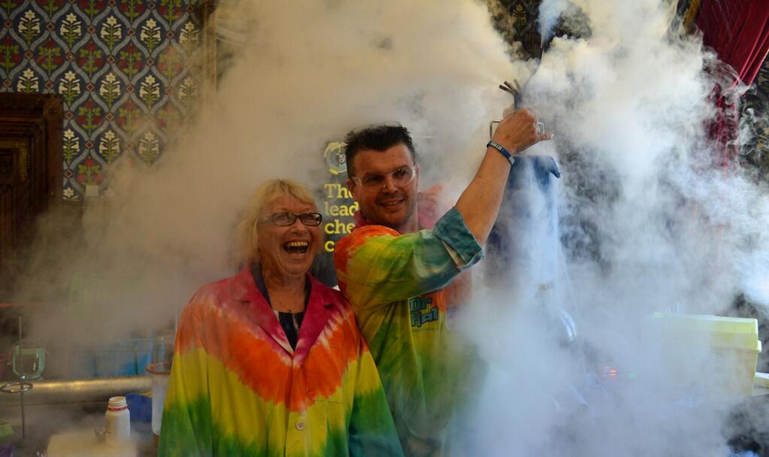

Slide 30
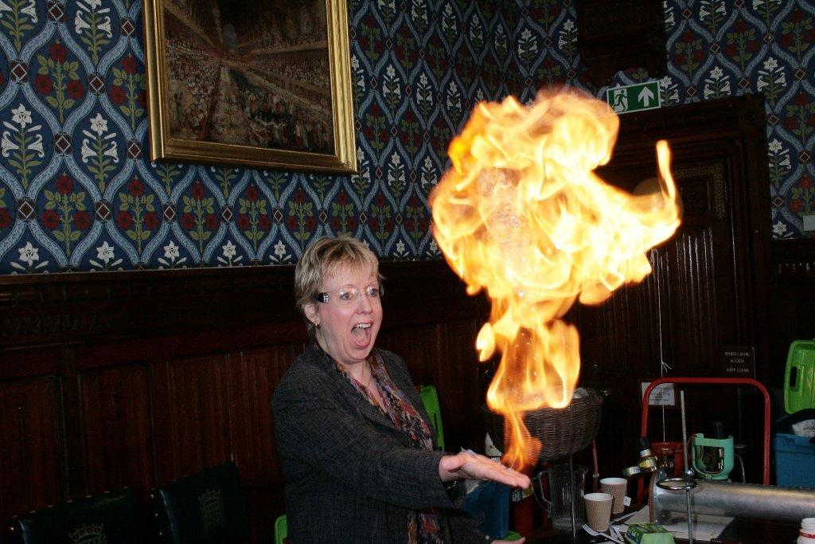

Slide 31
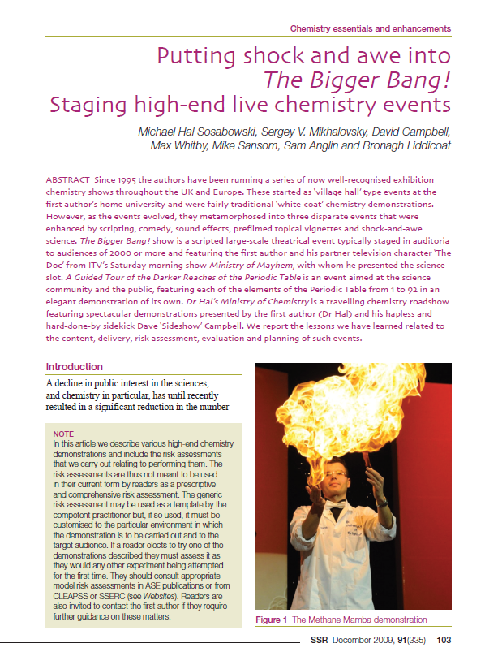


Slide 32


Slide 33


Slide 34
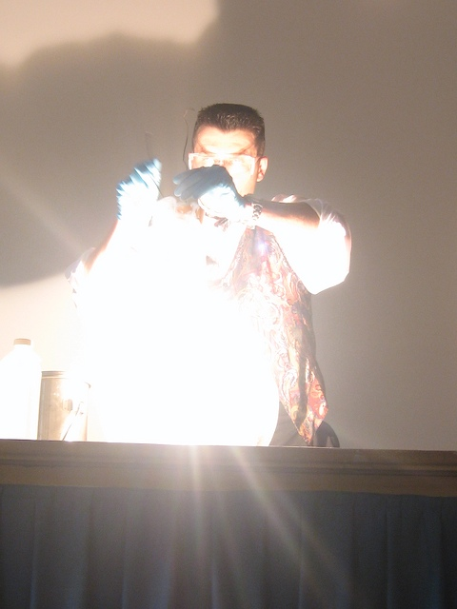
Notes:
I am normally introduced by an instructor - I then say who I am and point out that I have some service as a PC at Hammersmith (MPS)

Slide 35
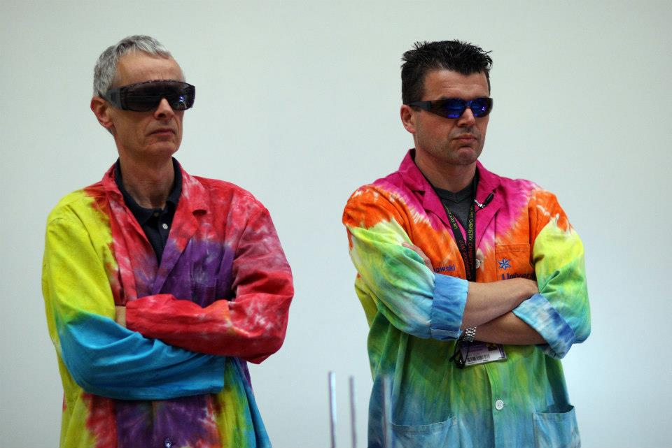
Notes:
I am normally introduced by an instructor - I then say who I am and point out that I have some service as a PC at Hammersmith (MPS)

Slide 36
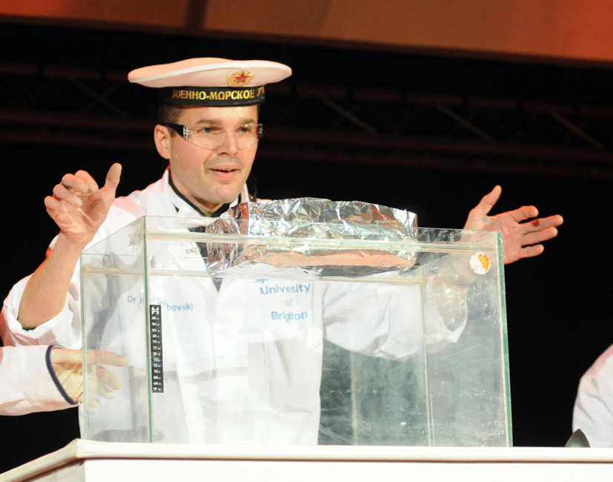

Slide 38
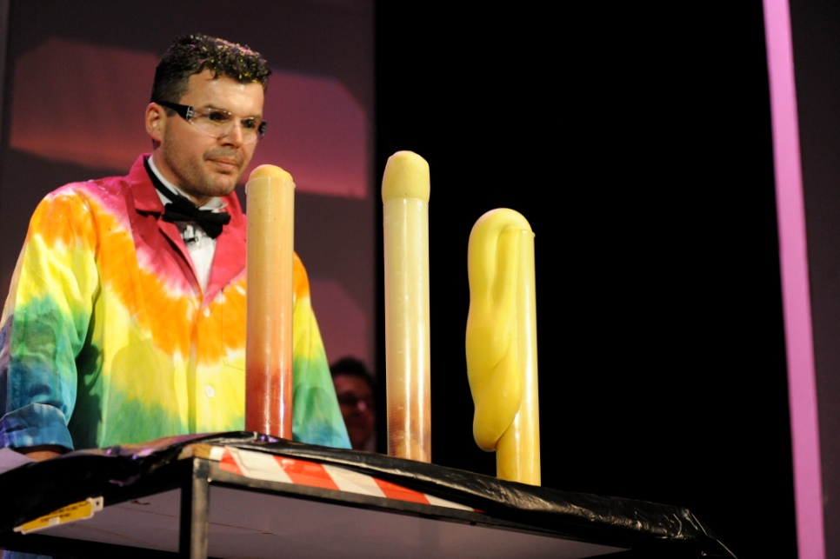

Slide 39


Slide 40
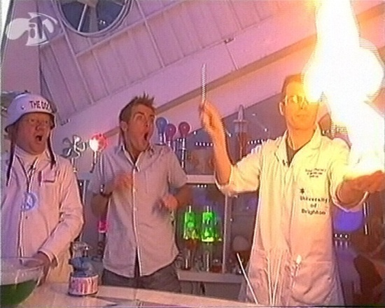
Dr Michael Hal Sosabowski
Notes:
I am normally introduced by an instructor - I then say who I am and point out that I have some service as a PC at Hammersmith (MPS)

Slide 41
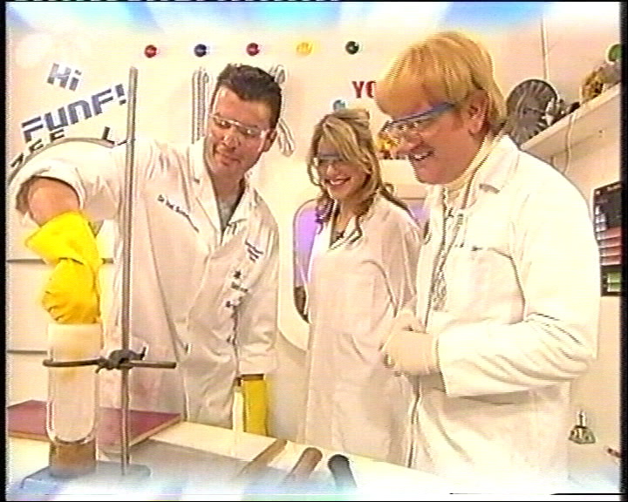
Dr Michael Hal Sosabowski
Notes:
I am normally introduced by an instructor - I then say who I am and point out that I have some service as a PC at Hammersmith (MPS)

Slide 42
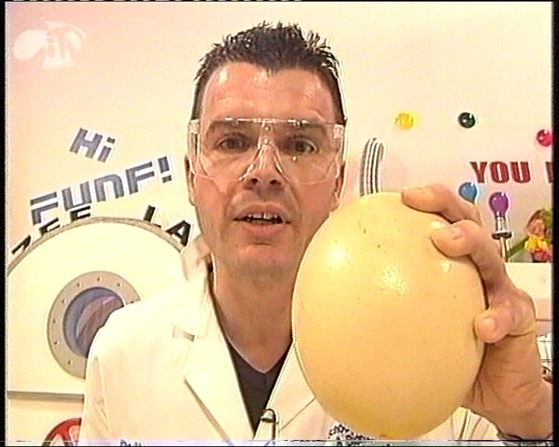
Dr Michael Hal Sosabowski
Notes:
I am normally introduced by an instructor - I then say who I am and point out that I have some service as a PC at Hammersmith (MPS)

Slide 43
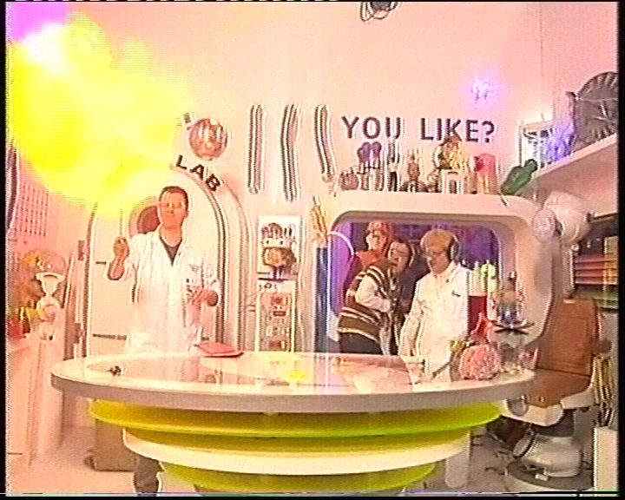
Notes:
I am normally introduced by an instructor - I then say who I am and point out that I have some service as a PC at Hammersmith (MPS)

Slide 44
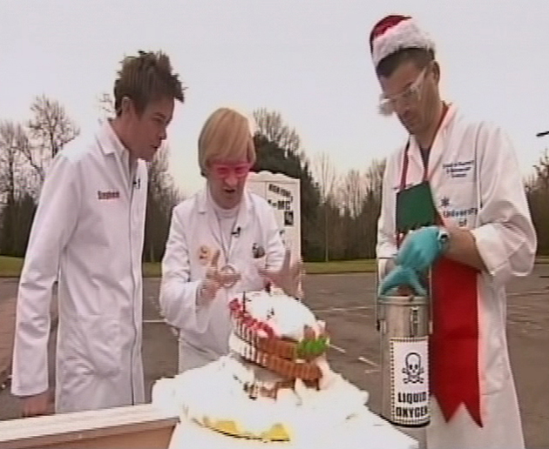
Notes:
I am normally introduced by an instructor - I then say who I am and point out that I have some service as a PC at Hammersmith (MPS)

Slide 45
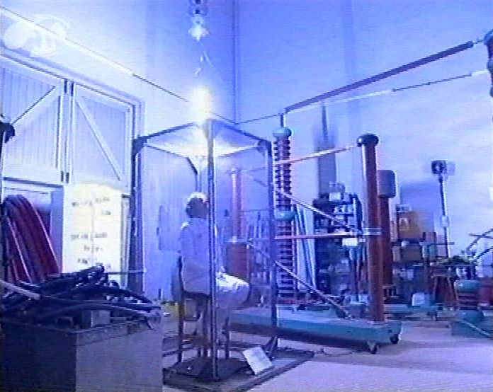
Notes:
I am normally introduced by an instructor - I then say who I am and point out that I have some service as a PC at Hammersmith (MPS)

Slide 46
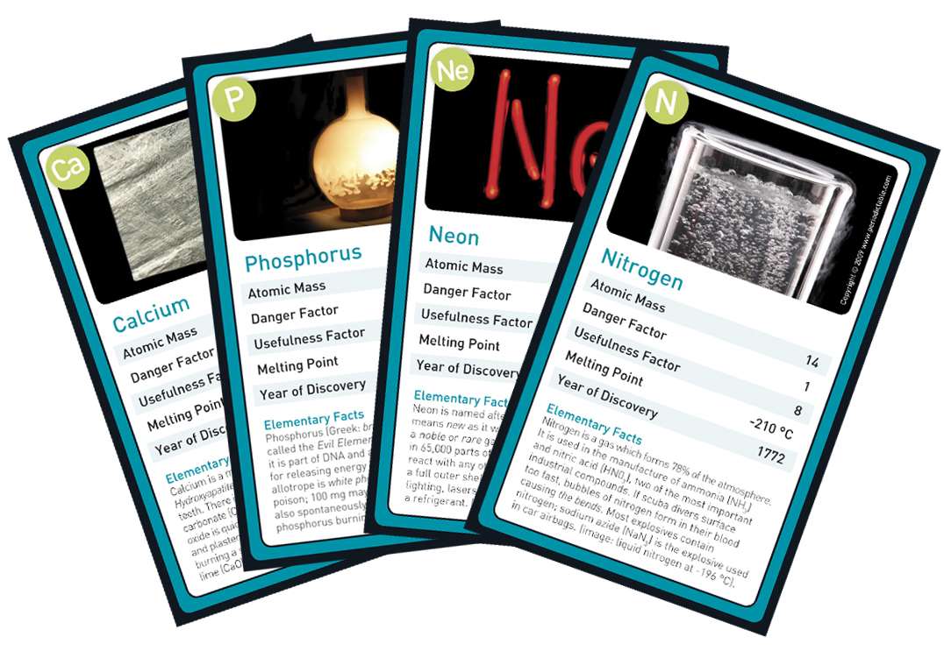

Slide 47
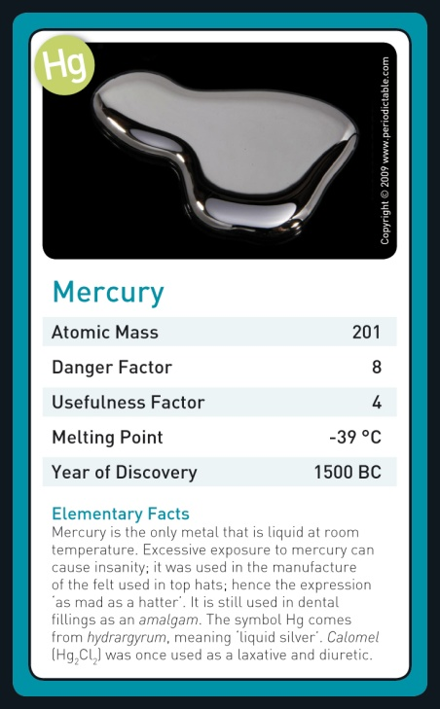

Slide 48
Showmanship Devices for Science Teaching
Develop your routine until you almost look carelessly efficient…..
Notes:
This lecture aims to pitch some of the common attributes of drugs of abuse to Sector/Relief teams at an appropriate, entertaining and informative level.
The author’s Teaching philosophy is that the half life of knowledge gained ‘merely’ to pass exams is quite short. The half life of knowledge gained in an entertaining, interesting an unusual way, knowledge gained for knowledge’s sake is much longer. There may be slides which upon first inspection don’t appear completely relevant – they provide material for facilitating interest and academic curiosity. The lecture is therefore also interspaced with numerous (and hopefully in some cases, humorous) asides, anecdotes and stories. The author is an ex-PC and is in the fortunate position of being able to approach material from two angles; as an ex-PC he has some inherent credibility due to shared experience with the target audience. This factor allows him to reach out to otherwise difficult-to-get-at learners in what is an environment that has sometimes been traditionally (and understandably) reserved with respect to outside speakers. Once these barriers are overcome, the second angle from which he can approach is that of his subject discipline (synthetic medicinal chemistry) from which he pitches the matters in hand at an appropriate level; one that is understandable for the audience in question without being patronising.

Slide 49
Showmanship Devices for Science Teaching
Try to strategically place hooks to emotionally engage your audience throughout the class/show...
Notes:
Most participants will be aware of depression or bipolar disorder and so this again reinforces the basis for these phenomena. Once again – understanding of this section is important for painting the picture of why subjects become addicted to drugs of abuse and can assist with developing an insightful understanding and ultimately empathy if not sympathy with those affected…

Slide 50
Showmanship Devices for Science Teaching
Develop your basic demonstrations into polished, complete routines:
Routine = demo + storyline + your personality..
Notes:
Most participants will be aware of depression or bipolar disorder and so this again reinforces the basis for these phenomena. Once again – understanding of this section is important for painting the picture of why subjects become addicted to drugs of abuse and can assist with developing an insightful understanding and ultimately empathy if not sympathy with those affected…

Slide 51
Showmanship Devices for Science Teaching
Make them like you; if they like you, they are more likely to listen to you;
Notes:
Most participants will be aware of depression or bipolar disorder and so this again reinforces the basis for these phenomena. Once again – understanding of this section is important for painting the picture of why subjects become addicted to drugs of abuse and can assist with developing an insightful understanding and ultimately empathy if not sympathy with those affected…

Slide 52
Showmanship Devices for Science Teaching…
Your audience will feel what you feel (emotional contagion);
Notes:
Most participants will be aware of depression or bipolar disorder and so this again reinforces the basis for these phenomena. Once again – understanding of this section is important for painting the picture of why subjects become addicted to drugs of abuse and can assist with developing an insightful understanding and ultimately empathy if not sympathy with those affected…

Slide 53
Showmanship devices for science demonstration shows…
Make them care, then make them wait, create suspense through developing
Curiosity (what will happen next?);
Uncertainty (will that really work?) or;
Anticipation (this is going to be amazing when it finally happens)…
Notes:
Most participants will be aware of depression or bipolar disorder and so this again reinforces the basis for these phenomena. Once again – understanding of this section is important for painting the picture of why subjects become addicted to drugs of abuse and can assist with developing an insightful understanding and ultimately empathy if not sympathy with those affected…

Slide 54
Showmanship Devices for Science Teaching
Use volunteers to be proxies for the audience, treat them well, and send them back to their seats as heroes.
Notes:
Most participants will be aware of depression or bipolar disorder and so this again reinforces the basis for these phenomena. Once again – understanding of this section is important for painting the picture of why subjects become addicted to drugs of abuse and can assist with developing an insightful understanding and ultimately empathy if not sympathy with those affected…

Slide 55
Showmanship Devices for Science Teaching
The illusion of the ‘first time’;
Notes:
Most participants will be aware of depression or bipolar disorder and so this again reinforces the basis for these phenomena. Once again – understanding of this section is important for painting the picture of why subjects become addicted to drugs of abuse and can assist with developing an insightful understanding and ultimately empathy if not sympathy with those affected…

Slide 56
Showmanship Devices for Science Teaching
“Presenter in trouble”
Deliberately let or make things go “wrong”…
Notes:
Most participants will be aware of depression or bipolar disorder and so this again reinforces the basis for these phenomena. Once again – understanding of this section is important for painting the picture of why subjects become addicted to drugs of abuse and can assist with developing an insightful understanding and ultimately empathy if not sympathy with those affected…

Slide 57
Showmanship devices for science demonstration shows…
Presenter in trouble – EVEN if it goes wrong – its OK the audience will love it….that's live science!
Use jeopardy to good, high tension effect…
Notes:
Most participants will be aware of depression or bipolar disorder and so this again reinforces the basis for these phenomena. Once again – understanding of this section is important for painting the picture of why subjects become addicted to drugs of abuse and can assist with developing an insightful understanding and ultimately empathy if not sympathy with those affected…

Slide 58
Showmanship Devices for Science Teaching
Rule of threes in comedy – do something; do it again; do it a third time...
Notes:
Most participants will be aware of depression or bipolar disorder and so this again reinforces the basis for these phenomena. Once again – understanding of this section is important for painting the picture of why subjects become addicted to drugs of abuse and can assist with developing an insightful understanding and ultimately empathy if not sympathy with those affected…

Slide 59
Showmanship devices for science demonstration shows…
Use back references to earlier events in the class or show…
Notes:
Most participants will be aware of depression or bipolar disorder and so this again reinforces the basis for these phenomena. Once again – understanding of this section is important for painting the picture of why subjects become addicted to drugs of abuse and can assist with developing an insightful understanding and ultimately empathy if not sympathy with those affected…

Slide 60


