Slide 1
Extra slides for MIPSfpga training – 2016 USA
Prerequisites, roadmap and project discussion

Slide 2
Extra slides for MIPSfpga training
Prerequisites
What do we expect from the attendees to know
Pointers to the specific extra slides to understand the missing concepts
We are interested to accommodate both people with EE and CS backgound
Road map for MIPSfpga
Additional labs that explore caches, interrupts and memory management
Labs to investigate the processor’s insides, how pipeline works
Adding custom instructions using CorExtend / UDI interface (User Defined Instructions)

Slide 3
Prerequisites
Questions to ask before the seminar
How many of you can program in C?
How many of you understand any assembly language?
See How to learn MIPS assembly language fast
How many of you know Verilog or VHDL?
See The concepts of HDL and RTL-to-GDSII design flow
How many of you understand what is FPGA?
See Intro to FPGAs, the need and the solution
How many of you understand microarchitecture / pipelining?
Do you know the difference between architecture and microarchitecture?
If not, see The concepts of microarchitecture and pipelining

Slide 4
How to learn MIPS assembly language fast
One of prerequisites for using MIPSfpga efficiently

Slide 5
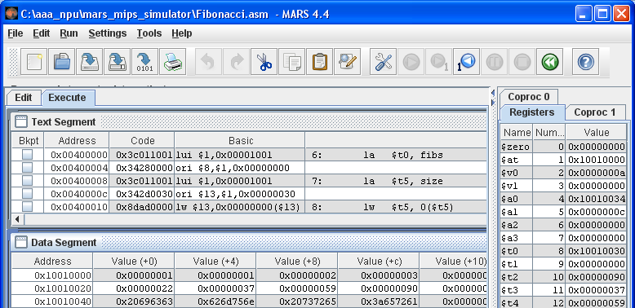
MARS simulator from University of Missouri
http://courses.missouristate.edu/KenVollmar/MARS/

Slide 6
HDL and RTL-to-GDSII design flow
One of prerequisites for understanding MIPSfpga

Slide 7
How SoC and IP blocks are designed
The base is RTL-to-GDSII Design Flow
The mainstream design methodology during the last 25 years
RTL – Register Transfer Level
A way to define functionality of a circuit
Describes how its state changes each clock cycle
Uses text languages Verilog and VHDL for design entry
GDSII – Graphics Database System II
SoC designer sends it to the factory to manufacture the chip
The database format describes the geometrical shapes
GDSII file is used to create photomasks and finally microchips

Slide 8
Key steps from RTL to GDSII
Those steps are facilitated by Electronic Design Automation (EDA) software
Logic Synthesis
Input: the description of the circuit behavior in Verilog or VHDL
Output: a graph (called netlist) that consists of logic elements and wires
Placement
Finds the positions of logic elements on a microchip for maximum efficiency
Routing
Connecting placed logic elements by wires

Slide 9
An example: a counter described in Verilog
module counter
(
input clock,
input reset,
output logic [1:0] n
);
always @(posedge clock)
begin
if (reset)
n <= 0;
else
n <= n + 1;
end
endmodule

Slide 10
What the counter circuit does

Slide 11
The counter circuit after logic synthesis

Slide 12
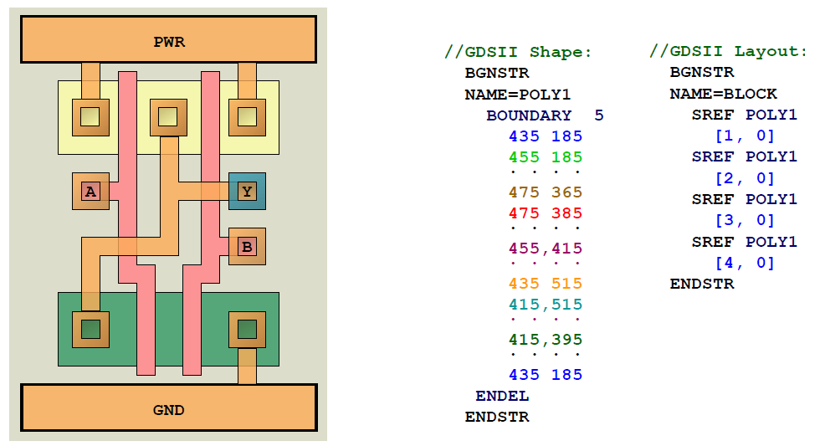
How GDSII file looks like
This slide is from course of Charles Dancak cdancak@ucsc.edu in University of California Santa Cruz Silicon Valley Extension

Slide 13
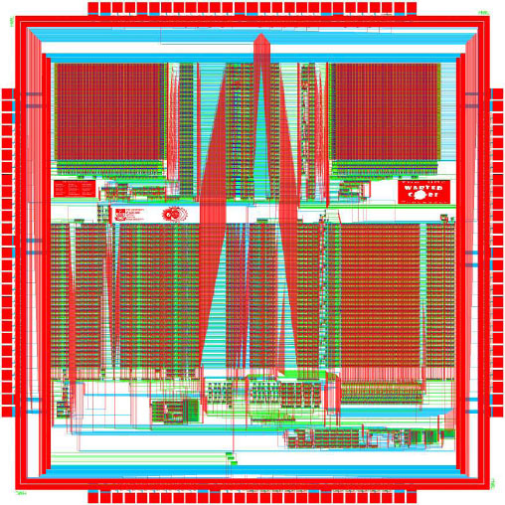
An example of the final results
After logic synthesis, placement and rounting
A simple implementation of MIPS architecture
Created by students in Harvey Mudd College, California
The source - http://www.staticfreesoft.com/electricGallery.html

Slide 14
Introduction to FPGAs

Slide 15
Suppose a student wants to make his own chip
What to do?
A commercial order for a chip on a foundry like TSMC is too expensive
> $1M typical initial cost – not for a student’s budget
Using Multi-Project-Wafer (MPW) service through MOSIS or Europractice
$X0,000 – still too expensive, maybe for very advanced research projects
Simulation using HDL simulation software on a workstation
Several orders of magnitude slower than a chip

Slide 16
A solution - FPGA
Field Programmable Gate Array
Matrix of interconnected cells with changeable logical function
The function of a cell is defined by loading bitfile into configuration memory
Flexibility is achieved by using multiplexers connected to configuration memory bits
Advantages
Reprogrammable
Three orders of magnitude faster than software simulation on register transfer level
Small NRE (non-recurring engineering) cost, student boards start from less than $100
Disadvantages
Less capacity than ASIC (application-specific integrated cirtcuits)
Slower than ASIC, allows less clock frequency
Per unit cost of FPGA is much higher than high-volume ASIC of the same capacity

Slide 17
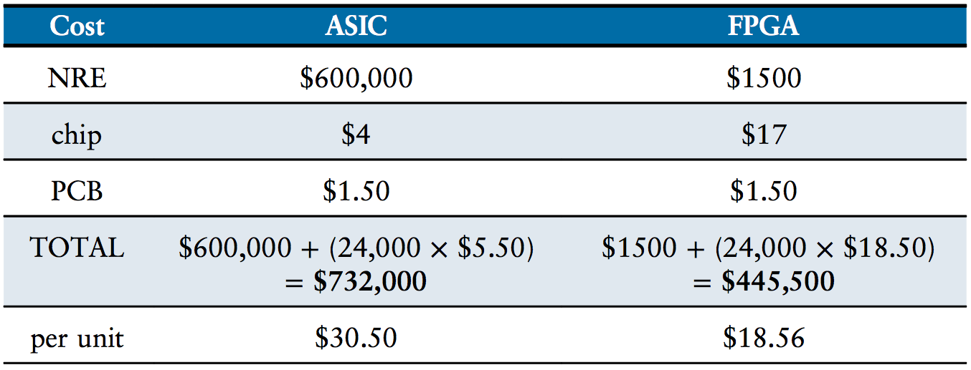
Not just for prototyping
In small volumes FPGA can be more cost-efficient than ASIC
The example is from Digital Design and Computer Architecture by David Harris and Sarah Harris, 2012

Slide 18
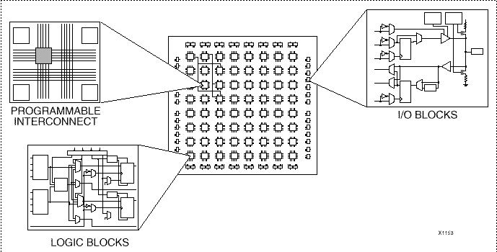
An idea about the structure of FPGA
The picture is from http://mazsola.iit.uni-miskolc.hu/cae/docs/pld1.en.html

Slide 19
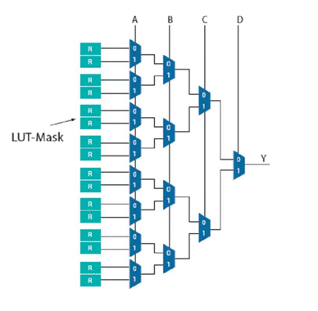
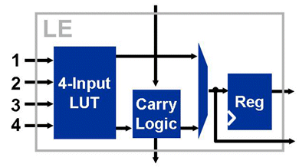
How reprogrammability works
Lookup table inside a logic cell uses multiplexers connected to memory bits
The picture is from http://www.eetimes.com/document.asp?doc_id=1274561

Slide 20
Specifics of Xilinx Artix-7 FPGA used in training

Slide 21
Specifics of Xilinx Artix-7 FPGA used in training

Slide 22
Specifics of Xilinx Artix-7 FPGA used in training

Slide 23
Microarchitecture / pipelining
One of prerequisites for using MIPSfpga efficiently

Slide 24
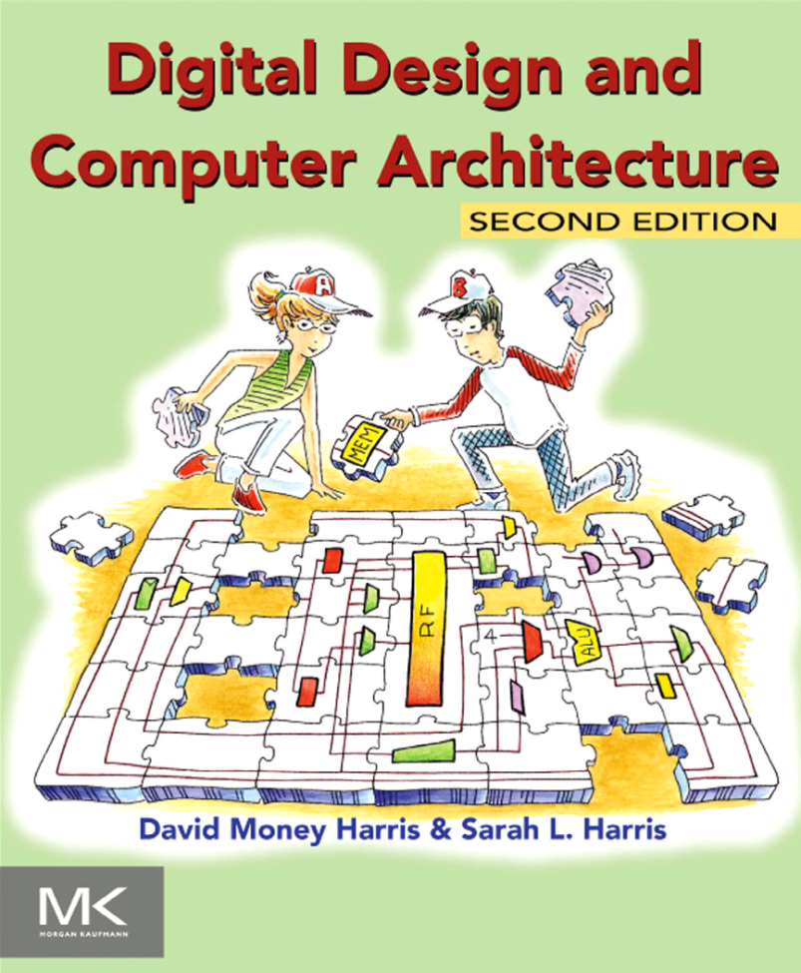
A recommended book
See Chapter 7 on microarchitecture
Introduction to all levels of abstraction:
Digital basics
Logic design
Microarchitecture
CPU blocks, structure of pipeline
This is how a hardware engineer sees the CPU
Architecture
Instruction set
This is how a software engineer sees the CPU
Link to OS and applications

Slide 25
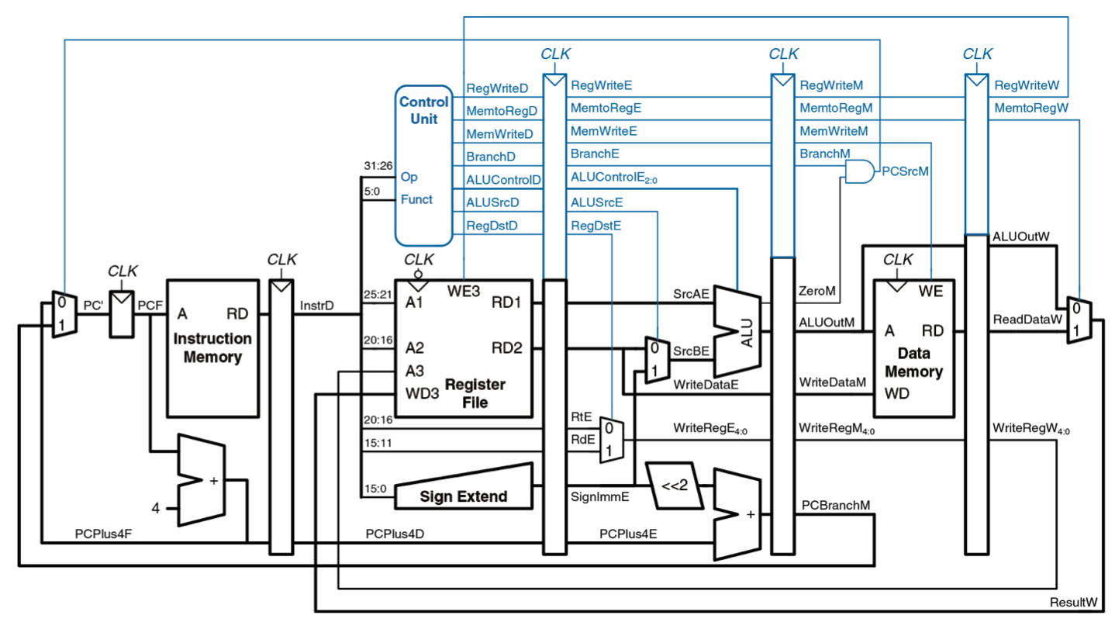
A simple beginner’s CPU from DDCA
A useful prequel to understand pipelining before experimenting with MIPSfpga
The example is from Digital Design and Computer Architecture by David Harris and Sarah Harris, 2012

Slide 26
An efficient way of teaching
First, students build their own simple CPU to get familiar with concepts of:
Datapath and controller
Pipeline and pipeline stages
Stalls and forwarding
Then, students experiment with a real industrial core, MIPSfpga:
Add peripherals to MIPSfpga system
Observe pipeline in action
Add their own instructions to the CPU using CorExtend interface
Modify the behavior of caches and memory management unit
Build multicore systems, with or without cache coherence
Cache coherence is difficult, requires adding MESI protocol and coherence manager

Slide 27
MIPSfpga roadmap
Advanced features for Getting Started / Fundamentals

Slide 28
Planned improvements in MIPSfpga Getting Started
Some of them are already available as experimental MIPSfpga+ version
Smaller bootcode - available
Allows using MIPSfpga with older and cheaper FPGA boards without sacrificing features
Digilent Basys3, Terasic / Altera DE0, DE0-Nano, DE0-CV, DE1
Loading software programs without BusBlaster and OpenOCD - available
For Xilinx, a new solution uses embedded UART in Digilent Nexys4 DDR and Basys3
For Altera, a new solution uses cheap FTDI USB-to-UART connector
VHDL version for top-level modules
Scripts for using MIPSfpga package on Linux
Better documentation that describes the structure of core design
For experimental version see https://github.com/MIPSfpga/mipsfpga-plus

Slide 29
Planned improvements in MIPSfpga Fundamentals
Some of them are already available as experimental MIPSfpga+ version
More peripherals – include Light sensor – available
Observe work of caches in real time - available
Cache miss signal is connected to LED
The core is running on very low frequency (a few cycles per second)
Interrupts
Adding CorExtend / User Defined Instructions
Observing pipeline bypass with different assembly programs
Changing cache replacement policies

Slide 30
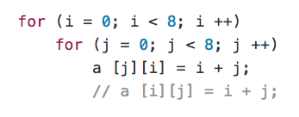
An example used to demo caches in action
For experimental version see https://github.com/MIPSfpga/mipsfpga-plus
A new version of MIPSfpga has switchable in run-time clock that can run either on 25 MHz or 12.5 Hz
First, the program is run on 25 MHz, than a user switches clock to 12.5 Hz and observes caches misses by watching blinking LED
The example shows different cache behavior when we fill the array by rows-first versus column-first

Slide 31
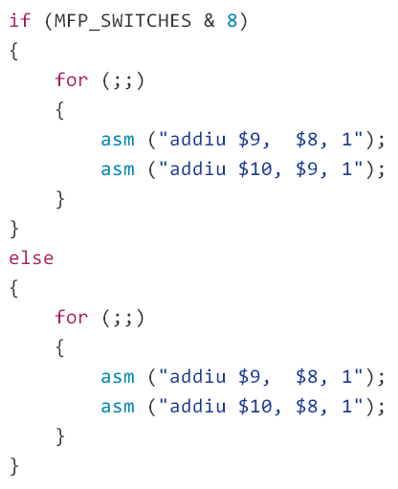
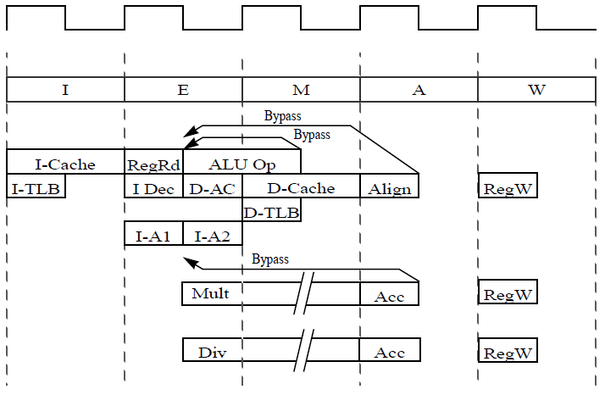
Observing pipeline bypasses
This lab also utilized switchable clock

Slide 32
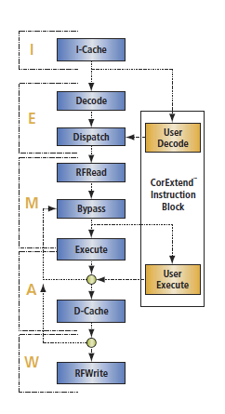
Adding custom instructions using CorExtend
Another name for CorExtend is UDI, User Defined Instructions, where “user” is “SoC designer”
New instructions are implemented in a separate module with well-defined interface accessible even for beginning students
UDI instructions
Have access to general-purpose registers
Do not stall pipeline unless required
Can have internal state
The protocol include a mechanism for exceptions
See http://zatslogic.blogspot.com/2016/01/using-mips-microaptiv-up-processor.html

Slide 33
Thank you!

