Slide 1





MIPSfpga
Using a Commercial MIPS Soft-Core in Computer
Architecture Education
Sarah L. Harris, University of Nevada, Las Vegas

Slide 2
Overview
Introduction
MIPSfpga Overview
Labs
Example Courses and Applications
Conclusion

Slide 3
Introduction
What is MIPSfpga?
  MIPSfpga is an unobfuscated soft-core commercial MIPS processor available from Imagination Technologies for academic use.
MIPSfpga supporting material is provided in three packages:
  MIPSfpga Getting Started Guide
  MIPSfpga Labs
  MIPSfpga SoC

Slide 4
MIPSfpga Materials
MIPSfpga Getting Started Guide
  Overall MIPSfpga system, setup, and tools
  Verilog files for the MIPSfpga core and system
MIPSfpga Labs
  25 hands-on labs for experimenting with, analyzing, and modifying the MIPSfpga system
MIPSfpga SoC
  MIPSfpga as the core of a system-on-chip that runs Linux

Slide 5
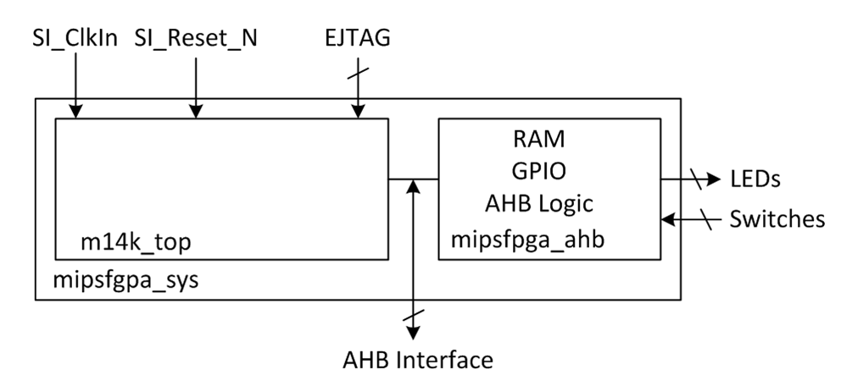
MIPSfpga System
MIPSfpga Core
Soft-core available in Verilog
System modules available in Verilog and VHDL

Slide 6
MIPSfpga: microAptiv Core
Commercial microAptiv core
  5-stage pipeline
  Set-associative I & D caches
  MMU (memory management unit) with TLB
  Performance counters
  No DSP, Coprocessor 2, or shadow registers
  Interfaces:
    AHB-Lite bus
    EJTAG programmer/debugger
    CorExtend for user-defined instructions

Slide 7
How to Run Programs on MIPSfpga?
In Simulation:
  ModelSim
  Vivado built-in simulator
In Hardware:
  Load program into memory:
    at synthesis
    using EJTAG interface (using Bus Blaster Probe)
    using UART interface (i.e., using Nexys4 DDR’s existing programming cable or USB-UART FTDI board)

Slide 8
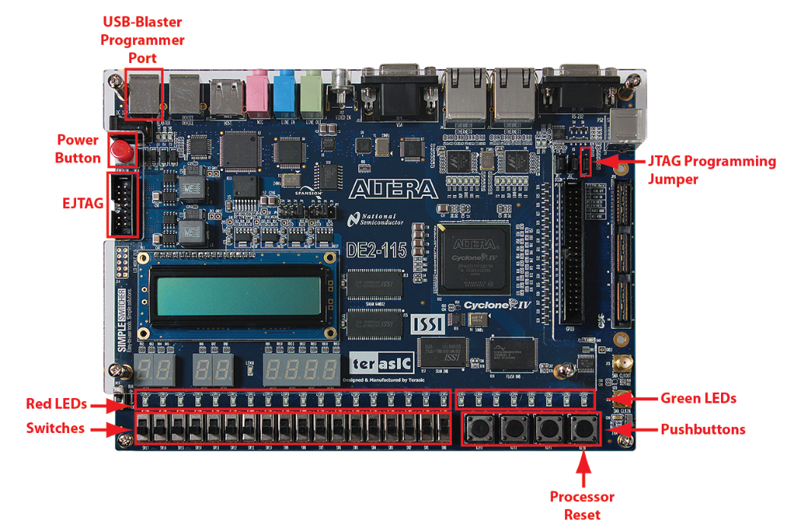
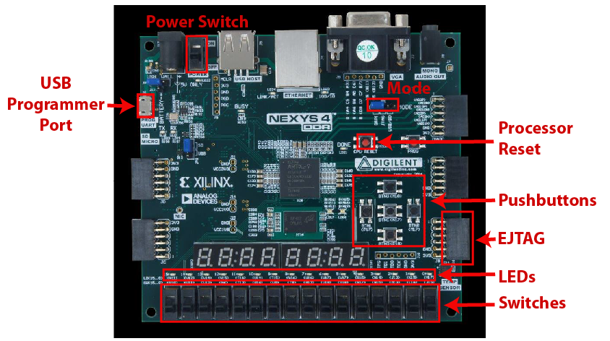
FPGA boards
Support for Nexys4 DDR and DE2-115 boards
Instructions on how to port it to other FPGA boards (end of Lab 1)
Nexys4 DDR
DE2-115

Slide 9
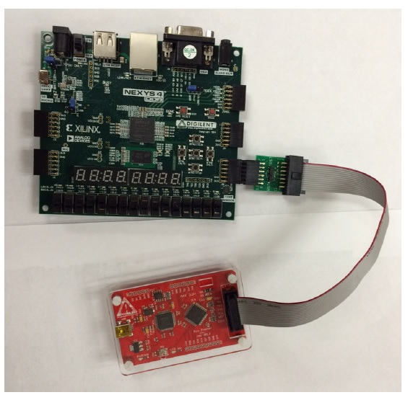
System setup: Nexys4 DDR + BusBlaster
Nexys4 DDR
Board
To USB port
To USB port
Bus Blaster
Probe

Slide 10
Overview
Introduction
MIPSfpga Overview
Labs
Example Courses and Applications
Conclusion

Slide 11
MIPSfpga Labs
Hands-on learning in areas including:
  System-on-chip (SoC) design
  Assembly language and C programming
  Instruction set architectures (ISAs)
  Design with hardware description languages (HDLs)
  Computer architecture
  Memory systems
  Memory-mapped I/O and interfacing with peripherals
  Interrupts
  Performance Counters

Slide 12
MIPSfpga Labs
Organized into four sections:
  Intro (Labs 1-4)
  I/O (Labs 5-13)
  Core (Labs 14-19)
  Memory (Labs 20-25)

Slide 13
MIPSfpga Labs
Section | Lab # | Lab Name
Intro | 1 | Vivado project for MIPSfpga
 | 2 | C programming on MIPSfpga
 | 3 | Assembly programming
 | 4 | More programming practice (optional)
I/O | 5 | 7-segment displays
 | 6 | Reaction timer
 | 7 | Audio
 | 8/9 | SPI light sensor / LCD
 | 10 | Interrupts
 | 11 | Direct memory access (DMA)
 | 12 | DES encryption
 | 13 | Performance counters

Slide 14
MIPSfpga Labs
Section | Lab # | Lab Name
Core | 14 | Instruction flow: ADD
 | 15 | Instruction flow: AND
 | 16 | Instruction flow: LW
 | 17 | Instruction flow: BEQ
 | 18 | Hazard logic
 | 19 | CorExtend: Adding user-defined instructions
Memory | 20 | Basic caching
 | 21 | Cache structure
 | 22 | Cache controller: Hit & miss management
 | 23 | Cache controller: Content management
 | 24 | Cache controller: Store and fill buffers
 | 25 | Scratchpad RAM

Slide 15
Overview
Introduction
MIPSfpga Overview
Labs
Example Courses and Applications
Conclusion

Slide 16
Example Courses and Applications
Course 1: 4th year Integrated Systems Architecture Course
Course 2: 4th year/Master’s level Processor and I/O Systems Lab
Hackathon
MIPSfpga is best used after learning the basics of
Digital Design, HDLs, and Computer Architecture.

Slide 17
Ex. 1: Systems Architecture Course
At UCM (Universidad Complutense de Madrid) 2017
Student background
  Digital & HDL design (VHDL)
  Computer Organization (MIPS ISA, single/multi-cycle processors, I/O systems)
  Programming (C++)

Slide 18
Course Contents
Module 1:
  Review: MIPS ISA, single/multi-cycle processors, I/O systems
Module 2:
  Pipelined processors
Module 3:
  Caches
Module 4:
  SoC and embedded system design

Slide 19
Course Materials
Textbook:
  Digital Design and Computer Architecture, 2nd Edition (Harris & Harris, Elsevier © 2012)
Slides:
  Extended versions of the slides provided with the book and with MIPSfpga Labs
Labs:
  MIPSfpga materials (MIPSfpga Labs and MIPSfpga SoC)
Exercises:
  Worksheets adapted from textbook and labs

Slide 20
Course Schedule
Lectures: 24 1.5-hour lessons, 2 per week
Lab sessions 12 2-hour sessions, 1 per week
  Module 1: MIPS ISA & Hardware (5 weeks)
    Install MIPSfpga tools and build MIPSfpga in Vivado (MIPS GSG & Lab 1)
    Review MIPS ISA: assembly & C programming (Labs 2-4)
    Review: I/O Systems (Lab 5: Add 7-segment displays)
  Module 2: Pipelined Processor (3 weeks)
    Labs 13-18 (ADD, AND, LW, BEQ instruction flow, Hazard Unit)
  Module 3: Cache Hierarchy (3 weeks)
    Labs 22A and 22B (Cache hits, Cache misses)
  Module 4: SoC and Embedded System Design (1 week)
    MIPSfpga SoC Starter Tutorial

Slide 21
Ex. 2: Processor & I/O Systems Lab
At TUD (Technical University of Darmstadt, Germany) in 2016
Student background
  Digital & HDL design (VHDL)
  Computer Organization (MIPS ISA, single/multi-cycle processors, I/O systems)
  Programming

Slide 22
Course Materials
Textbook:
  Digital Design and Computer Architecture, 2nd Edition (Harris & Harris, Elsevier © 2012)
Slides:
  Extended versions of the slides provided with the book and MIPSfpga Labs
Labs:
  Textbook and MIPSfpga Labs
Lab kit cost: $15 + Nexys4 DDR board ($159) & Bus Blaster probe ($50). Total: $234

Slide 23
Course Contents
Lab | MIPSfpga Lab # | Description | Duration
1 | Lab 3 | MIPS Assembly Programming (using simulator) | 1 week
2 | Lab from book | MIPS Single-Cycle Processor | 1 week
3 | Lab from book | MIPS Pipelined Processor | 2 weeks
4 | Lab 1 | MIPSfpga Tutorial | 1 week
5 | Lab 7 | MIPSfpga Memory-mapped I/O: Buzzer | 1 week
6 | Lab 9 | MIPSfpga Memory-mapped I/O: LCD | 2 weeks
7 | Lab 11 | MIPSfpga DMA Engine | 2 weeks
8 | Lab 12 | MIPSfpga DES Encryption with DMA | 2 weeks

Slide 24
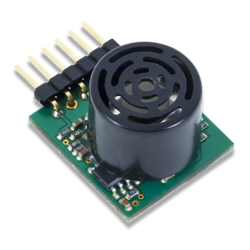
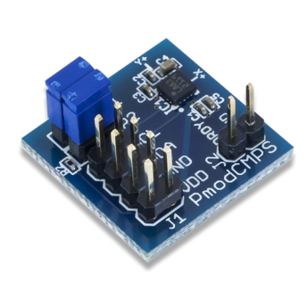
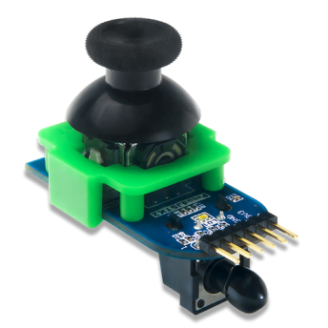
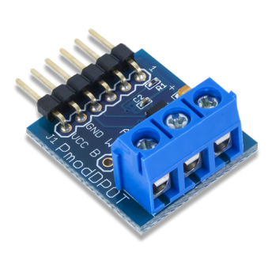
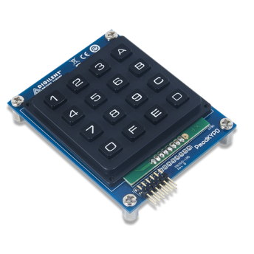
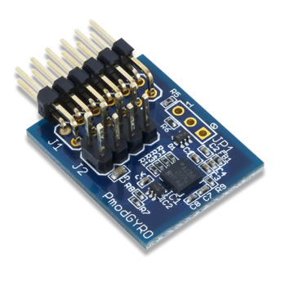
Ex. 3: Hackathon
Seminars in Russia, Ukraine and Kazakhstan in 2015/2016
MIPSfpga integrated into courses / labs
Culminated in Hackathon where students interfaced MIPSfpga to peripherals using SPI, I²C, etc. (see MIPSfpga I/O Labs)
http://store.digilentinc.com/pmod-expansion-modules/pmod-boards/

Slide 25
Overview
Introduction
MIPSfpga Overview
Labs
Example Courses and Applications
Conclusion

Slide 26
MIPSfpga Comparisons
Name | Comparisons
Nios, Nios II, Microblaze, Cortex M0 Design Start | + Soft-core - Obfuscated
OpenSPARC, Leon | + Soft-core + Open-source - Few teaching materials - ISA not commonly used in academia
RISC-V, openRISC | + Soft-core + Open-source - Not a commercial core - Few teaching materials
MIPSfpga: + Unobfuscated soft-core
+ Commercial core (e.g., used in Microchip’s PIC32MZ)
+ Commonly taught ISA in academia
+ Robust teaching materials

Slide 27
Conclusions
MIPSfpga bridges the gap between toy processors and industry-level processors.
MIPSfpga is an excellent resource for courses in:
  Digital design, computer architecture, embedded systems, Memory systems, VLSI design, SoC design
MIPSfpga offers robust teaching materials best used in upper-division undergraduate or master’s-level courses.

Slide 28
MIPSfpga Materials & Support
MIPSfpga materials available on the Imagination University Program Website under Teaching Materials:
http://community.imgtec.com/university/university-registration
MIPSfpga Forum (technical support):
http://community.imgtec.com/forums/cat/mips-insider/mipsfpga/
Other Forums
  MIPS Tech Support (general questions):
http://community.imgtec.com/forums/cat/mips-insider/
  Imagination University Programme (curriculum discussions, IUP questions, etc. – no tech support):
http://community.imgtec.com/forums/cat/university/

Slide 29

Acknowledgements
Robert Owen
Sarah Harris
Daniel Chaver-Martinez
David Money Harris
Yuri Panchul
Bruce Ableidinger
Enrique Sedano
Zubair Kakakhel
Kent Brinkley
Chuck Swartley
Akhilesh Sandeep Thakur
Christian White
Sean Raby
Rick Leatherman
Matthew Fortune
Munir Hasan
Sachin Sundar
Michael Alexander
Sam Bobrowicz
Cathal McCabe
Roy Kravitz
Alexey Pereverzev
Nicholas Beser
Larissa Swanland
Clint Cole
Students and faculty at UCL
Ian Oliver
Steve Kromer
Parimal Patel
Jason Wong
Zhe Yang
Professor Dai
Zhongzheng (Jason) Wang
Bin He
Dennis Pinto

Slide 30
Thank you!
Any questions?

Slide 31
Extra Slides

Slide 32
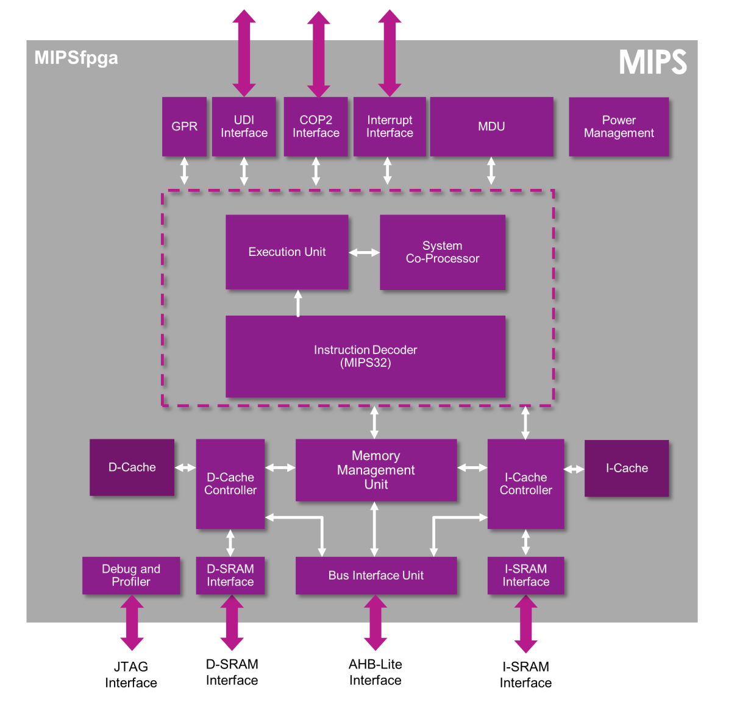
MIPSfpga Core

Slide 33
MIPSfpga 5-Stage Pipeline
# | Stage | Name | Description
1 | I | Instruction | Fetch Instruction
2 | E | Execution | Fetch operands from RF & perform ALU operation
3 | M | Memory | Access Memory
4 | A | Align | Align data to word boundary
5 | W | Writeback | Write result to RF

Slide 34
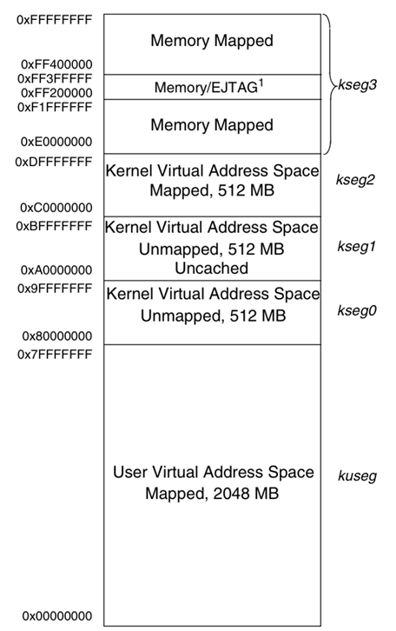
MIPSfpga Memory Map
32-bit virtual memory space (0x00000000 – 0xFFFFFFFF), broken up into different segments
On reset, processor begins in kernel mode and jumps to the reset vector at address 0xBFC00000 (mapped to physical address 0x1FC00000)

Slide 35
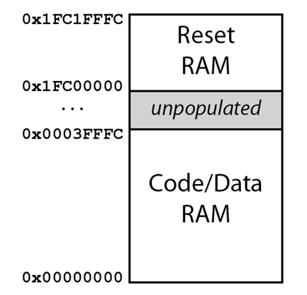
MIPSfpga System: Physical Memory
Boot Code:
Code executed at startup
(128 KB)
User Code/Data
(256 KB)

Slide 36
MIPSfpga Interfaces: AHB-Lite
Signal Name | Description
HADDR[31:0] | Address bus
HRDATA[31:0] | Read data bus
HWDATA[31:0] | Write data bus
HWRITE | Write enable
HCLK | Clock
H: prefix for AHB-Lite Interface signals in Verilog files

Slide 37
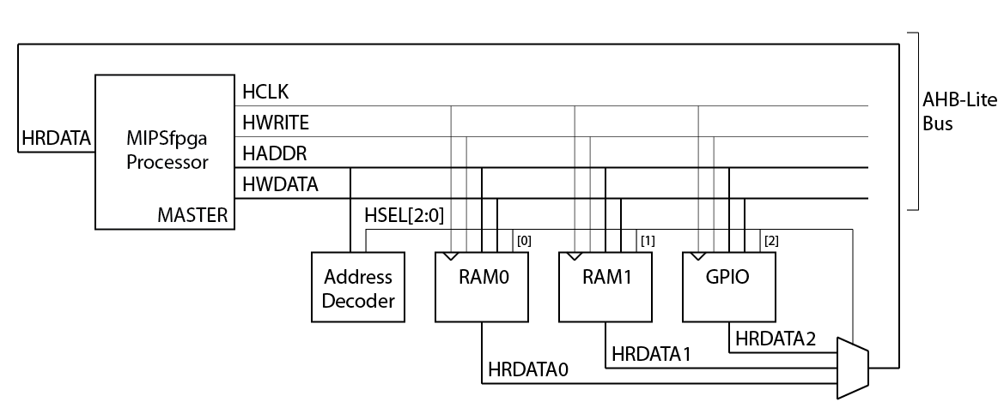
AHB-Lite Memory / Peripherals

Slide 38
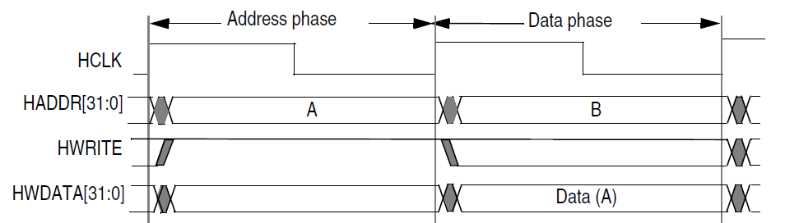
AHB-Lite Write Timing
Cycle 1: Address and Write Enable (HADDR & HWRITE)
Cycle 2: Write Data (HWDATA)

Slide 39
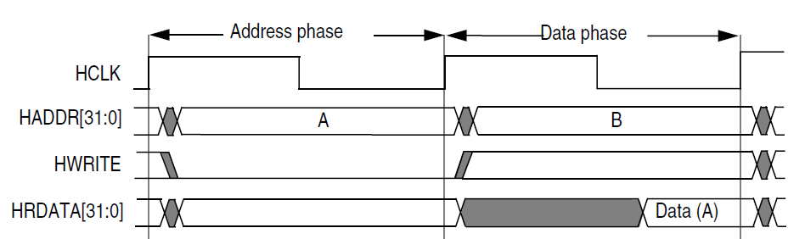
AHB-Lite Read Timing
Cycle 1: Address (HADDR) (also, HWRITE = 0)
Cycle 2: Read Data (HRDATA)

Slide 40
Memory-Mapped I/O
Signal Name | Virtual Address | Physical Address
IO_LEDR[15:0] | 0xbf800000 | 0x1f800000
IO_Switch[15:0] | 0xbf800008 | 0x1f800008
IO_PB[4:0] | 0xbf80000c | 0x1f80000c

Slide 41
Memory-Mapped I/O
Signal Name | Virtual Address | Physical Address
IO_LEDR[15:0] | 0xbf800000 | 0x1f800000
IO_Switch[15:0] | 0xbf800008 | 0x1f800008
IO_PB[4:0] | 0xbf80000c | 0x1f80000c
Write to 0xbf800000 writes to LEDs
// Write 0x543 to LEDs
addiu $7, $0, 0x543 # $7 = 0x543
lui $5, 0xbf80 # $5 = 0xbf800000 (LED address)
sw $7, 0($5) # LEDs = 0x543

Slide 42
Memory-Mapped I/O
Signal Name | Virtual Address | Physical Address
IO_LEDR[15:0] | 0xbf800000 | 0x1f800000
IO_Switch[15:0] | 0xbf800008 | 0x1f800008
IO_PB[4:0] | 0xbf80000c | 0x1f80000c
Write to 0xbf800000 writes to LEDs
Read from 0xbf800008 reads value of switches
// Read value of switches into $10
lui $5, 0xbf80 # $5 = 0xbf800000
lw $10, 8($5) # $10 = value of switches

Slide 43
Exampe Labs

Slide 44

Example: Lab 4 (Part 1)
Image Transformation:
  Skeleton code – students complete in C
  2 extra exercises – students complete in MIPS assembly
  Test/run lab on MIPSfpga

Slide 45
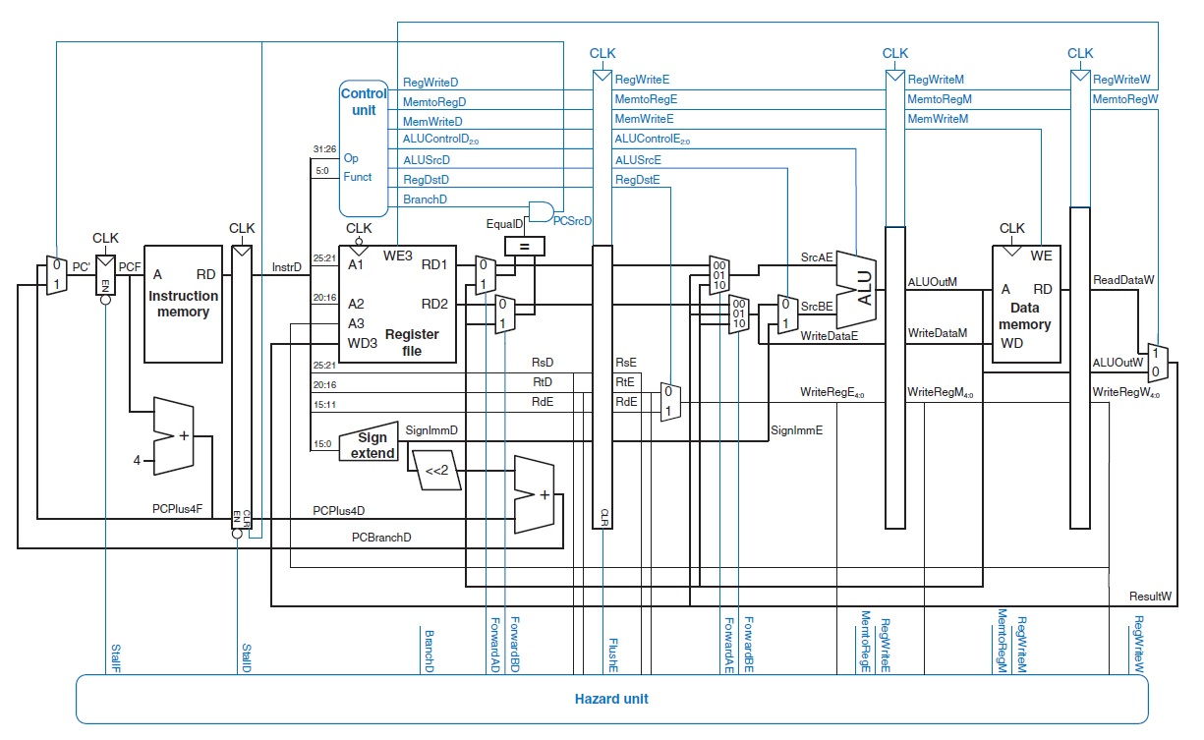
Example: Lab 13 (Part 2)
MIPS
Pipelined
Processor
from book

Slide 46
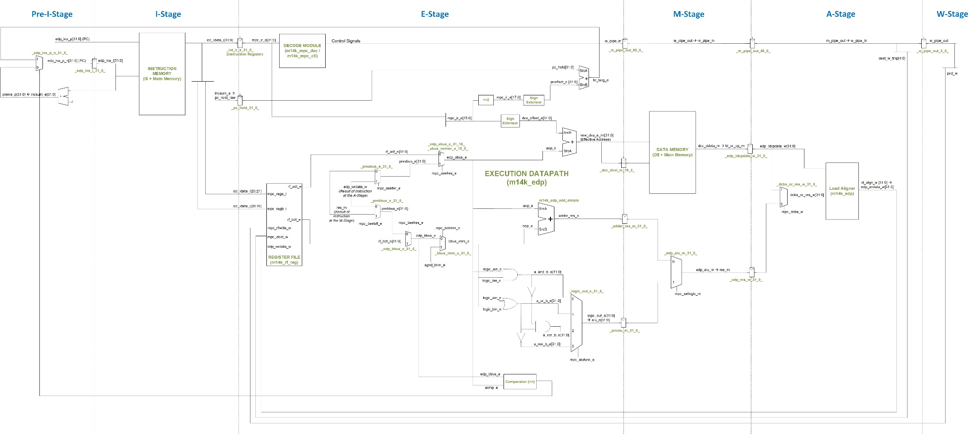
Example: Lab 13 (Part 2)
microAptiv pipelined
processor (MIPSfpga)

Slide 47
Example: Lab 13 (Part 2)
LUI $t0, 0x8000
ADDIU $t0, $t0, test_array
SUB $t1,$t1,$t1
SUB $t3,$t3,$t3
ADDI $t4,$0,1000
Loop1: BEQ $t3,$t4,Out
LW $t5,0($t0)
ADD $t1,$t1,$t5
ADDI $t0,$t0,4
ADDI $t3,$t3,1
B Loop1
Out: LUI $t3, 0x8000
ADDIU $t3, $t3, Addition
SW $t1,0($t3)
Analyze the data and control hazards:
  Processor from the book
  MicroAptiv
Determine CPI for the processor from the book
Determine CPI for microAptiv and measure it
Reorder the code and repeat the exercise

Slide 48
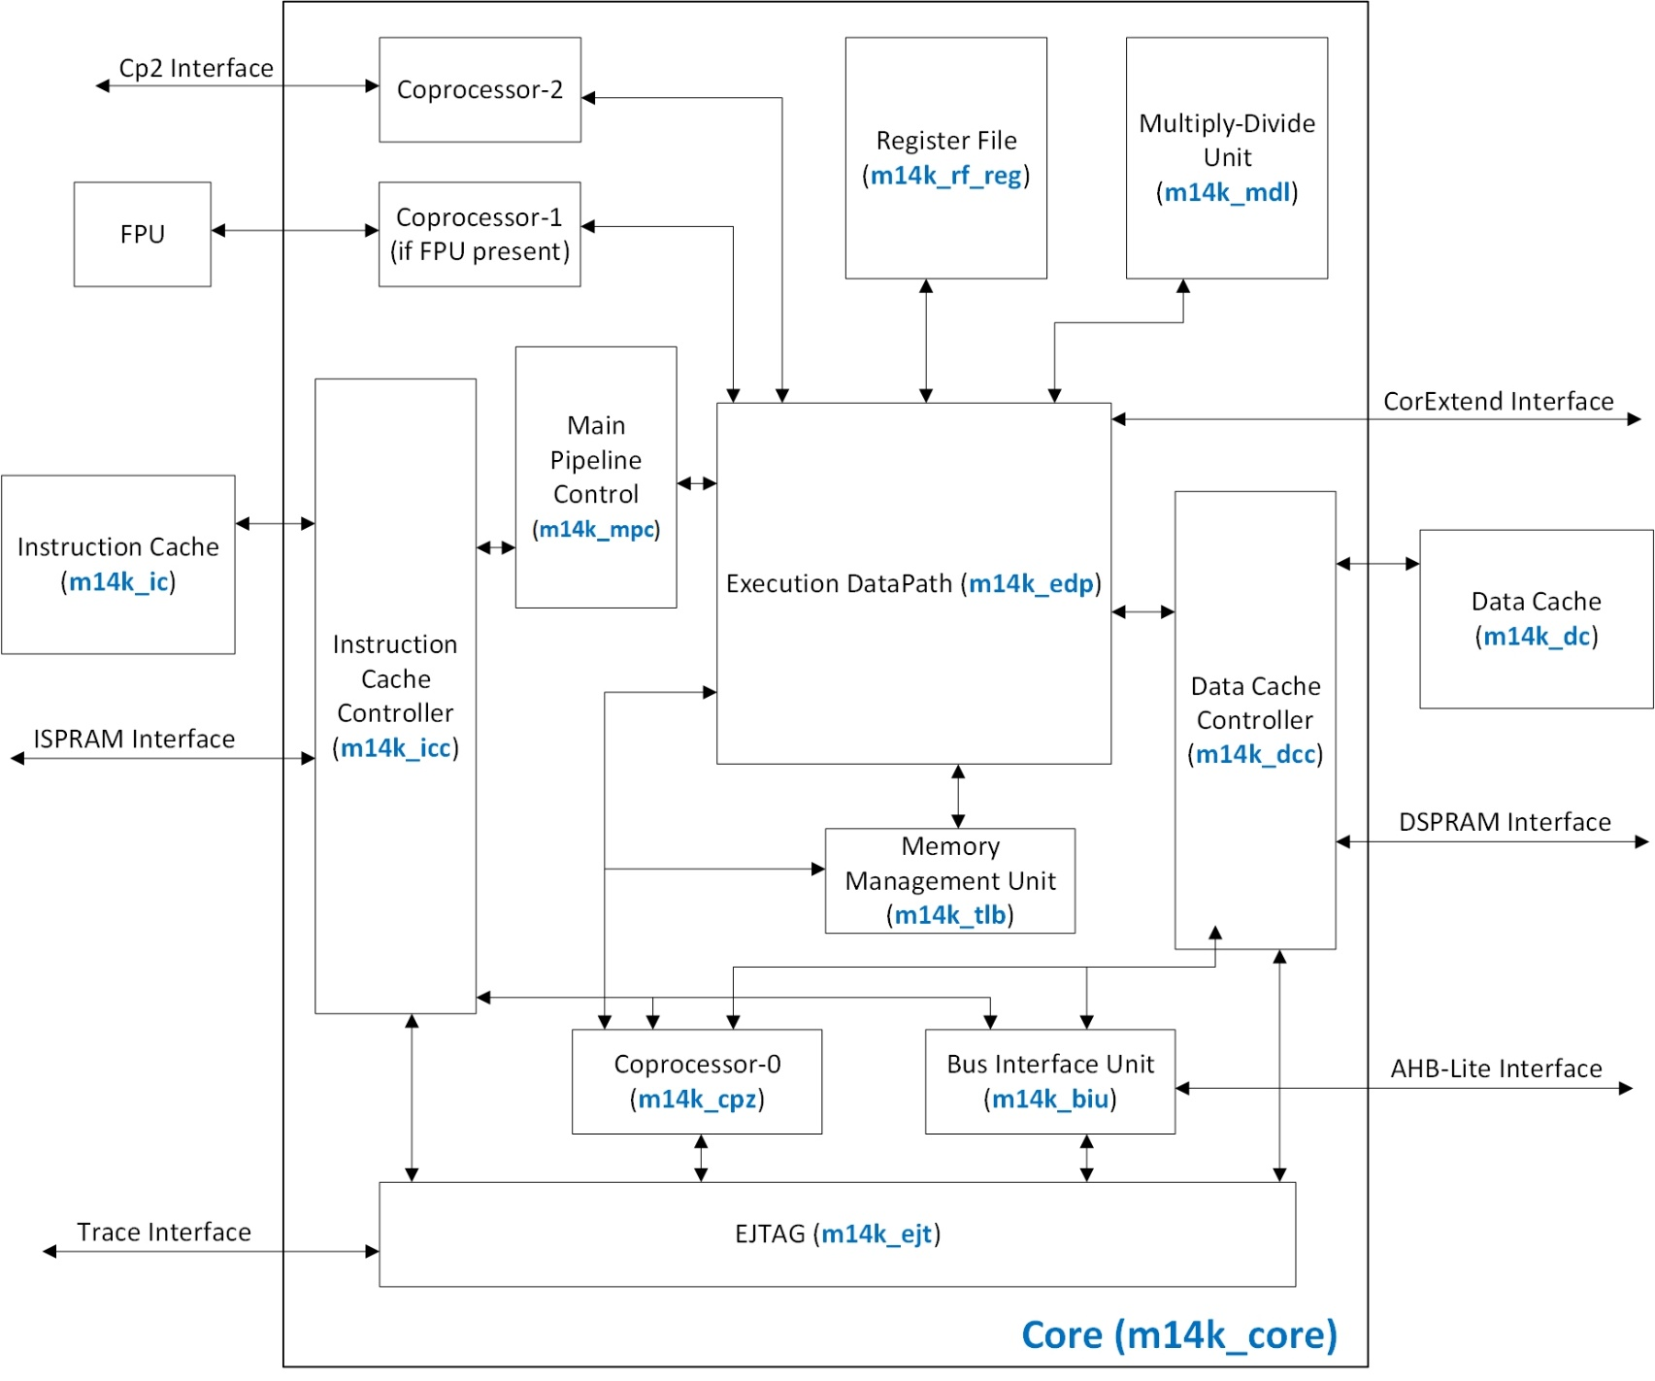
Lab 14: Add Instruction

Slide 49
Example: Lab 22-B: D$ Misses (Part 3)
Goal: Analyze I$/D$ miss management
Theoretical explanation of D$ miss management
D$ miss simulations
Exercises:
  Analyze a D$ hit
  Determine the miss penalty
  Code optimization techniques
    Array enlargement and array merging
    Loop interchange
    Blocking

Slide 50
Example: MIPSfpga-SoC – Starter Tutorial
Build a System On Chip based on microAptiv core and Xilinx IP blocks

Slide 51
MIPSfpga-SoC – Starter Tutorial
Run Linux and play with it
  Download the Bitstream
  Terminal Emulation – putty
  Run the bootram code
  Load Linux to memory via EJTAG
  Booting Linux
  Writing and Compiling a Program
  Reading the onboard temperature sensor via sysfs
  Accessing general-purpose I/Os via sysfs

