Slide 1
Chapter 1
Digital Design and Computer Architecture, 2nd Edition
David Money Harris and Sarah L. Harris

Slide 2
Chapter 1 :: Topics
Background
The Game Plan
The Art of Managing Complexity
The Digital Abstraction
Number Systems
Logic Gates
Logic Levels
CMOS Transistors
Power Consumption

Slide 3
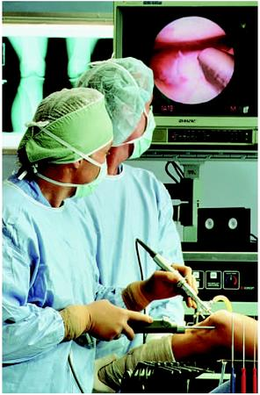
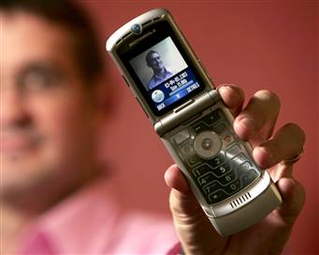
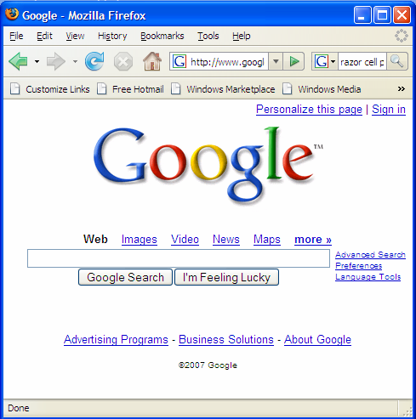
Background
Microprocessors have revolutionized our world
  Cell phones, Internet, rapid advances in medicine, etc.
The semiconductor industry has grown from $21 billion in 1985 to $300 billion in 2011

Slide 4
The Game Plan
Purpose of course:
  Understand what’s under the hood of a computer
  Learn the principles of digital design
  Learn to systematically debug increasingly complex designs
  Design and build a microprocessor

Slide 5
The Art of Managing Complexity
Abstraction
Discipline
The Three –Y’s
  Hierarchy
  Modularity
  Regularity

Slide 6
Abstraction
Hiding details when they aren’t important

Slide 7
Discipline
Intentionally restrict design choices
Example: Digital discipline
  Discrete voltages instead of continuous
  Simpler to design than analog circuits – can build more sophisticated systems
  Digital systems replacing analog predecessors:
    i.e., digital cameras, digital television, cell phones, CDs

Slide 8
The Three -Y’s
Hierarchy
  A system divided into modules and submodules
Modularity
  Having well-defined functions and interfaces
Regularity
  Encouraging uniformity, so modules can be easily reused

Slide 9
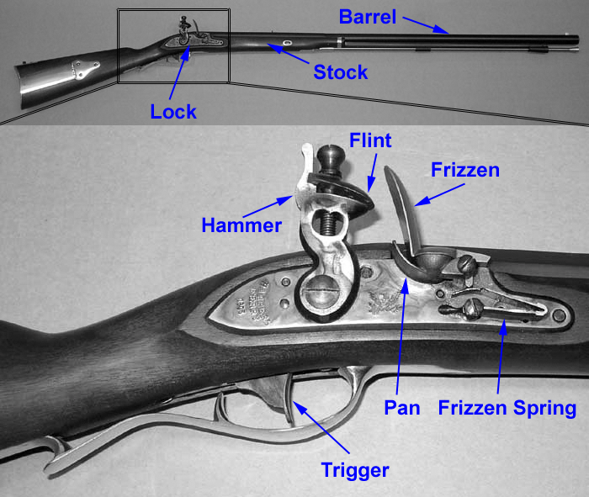
Example: The Flintlock Rifle
Hierarchy
  Three main modules: lock, stock, and barrel
  Submodules of lock: hammer, flint, frizzen, etc.

Slide 10
Example: The Flintlock Rifle
Modularity
  Function of stock: mount barrel and lock
  Interface of stock: length and location of mounting pins
Regularity
  Interchangeable parts

Slide 11
The Digital Abstraction
Most physical variables are continuous
  Voltage on a wire
  Frequency of an oscillation
  Position of a mass
Digital abstraction considers discrete subset of values

Slide 12
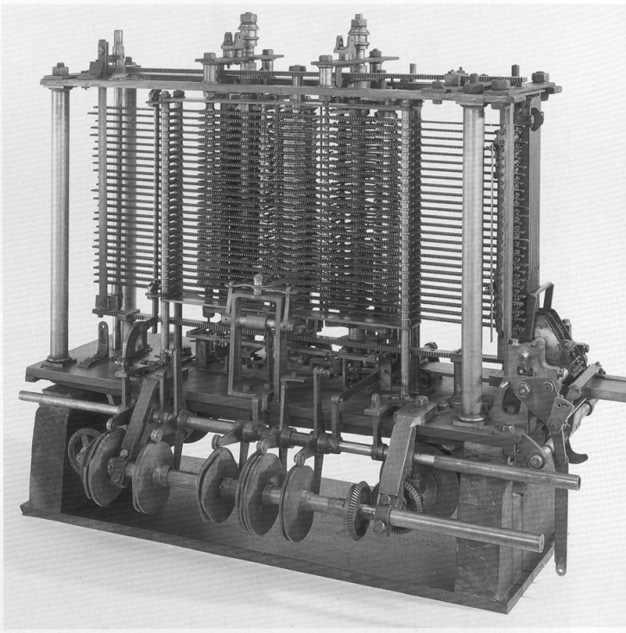
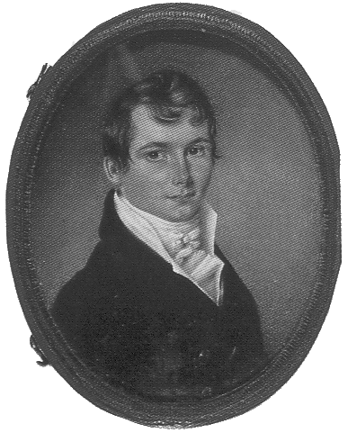
The Analytical Engine
Designed by Charles Babbage from 1834 – 1871
Considered to be the first digital computer
Built from mechanical gears, where each gear represented a discrete value (0-9)
Babbage died before it was finished

Slide 13
Digital Discipline: Binary Values
Two discrete values:
  1’s and 0’s
  1, TRUE, HIGH
  0, FALSE, LOW
1 and 0: voltage levels, rotating gears, fluid levels, etc.
Digital circuits use voltage levels to represent 1 and 0
Bit: Binary digit

Slide 14
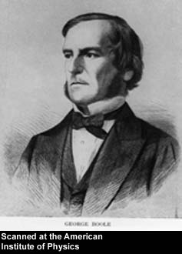
George Boole, 1815-1864
Born to working class parents
Taught himself mathematics and joined the faculty of Queen’s College in Ireland.
Wrote An Investigation of the Laws of Thought (1854)
Introduced binary variables
Introduced the three fundamental logic operations: AND, OR, and NOT.

Slide 15
Number Systems
Decimal numbers
Binary numbers

Slide 16
Number Systems
Decimal numbers
Binary numbers

Slide 17
Powers of Two
2⁰ =
2¹ =
2² =
2³ =
2⁴ =
2⁵ =
2⁶ =
2⁷ =
2⁸ =
2⁹ =
2¹⁰ =
2¹¹ =
2¹² =
2¹³ =
2¹⁴ =
2¹⁵ =

Slide 18
Powers of Two
2⁰ = 1
2¹ = 2
2² = 4
2³ = 8
2⁴ = 16
2⁵ = 32
2⁶ = 64
2⁷ = 128
Handy to memorize up to 2⁹
2⁸ = 256
2⁹ = 512
2¹⁰ = 1024
2¹¹ = 2048
2¹² = 4096
2¹³ = 8192
2¹⁴ = 16384
2¹⁵ = 32768

Slide 19
Number Conversion
Decimal to binary conversion:
  Convert 10011₂ to decimal
Decimal to binary conversion:
  Convert 47₁₀ to binary

Slide 20
Number Conversion
Decimal to binary conversion:
  Convert 10011₂ to decimal
  16×1 + 8×0 + 4×0 + 2×1 + 1×1 = 19₁₀
Decimal to binary conversion:
  Convert 47₁₀ to binary
  32×1 + 16×0 + 8×1 + 4×1 + 2×1 + 1×1 = 101111₂

Slide 21
Binary Values and Range
N-digit decimal number
  How many values?
  Range?
  Example: 3-digit decimal number:
N-bit binary number
  How many values?
  Range:
  Example: 3-digit binary number:

Slide 22
Binary Values and Range
N-digit decimal number
  How many values? 10^{N}
  Range? [0, 10^{N} - 1]
  Example: 3-digit decimal number:
    10³ = 1000 possible values
    Range: [0, 999]
N-bit binary number
  How many values? 2^{N}
  Range: [0, 2^{N} - 1]
  Example: 3-digit binary number:
    2³ = 8 possible values
    Range: [0, 7] = [000₂ to 111₂]

Slide 23
Hexadecimal Numbers
Hex Digit | Decimal Equivalent | Binary Equivalent
0 | 0
1 | 1
2 | 2
3 | 3
4 | 4
5 | 5
6 | 6
7 | 7
8 | 8
9 | 9
A | 10
B | 11
C | 12
D | 13
E | 14
F | 15

Slide 24
Hexadecimal Numbers
Hex Digit | Decimal Equivalent | Binary Equivalent
0 | 0 | 0000
1 | 1 | 0001
2 | 2 | 0010
3 | 3 | 0011
4 | 4 | 0100
5 | 5 | 0101
6 | 6 | 0110
7 | 7 | 0111
8 | 8 | 1000
9 | 9 | 1001
A | 10 | 1010
B | 11 | 1011
C | 12 | 1100
D | 13 | 1101
E | 14 | 1110
F | 15 | 1111

Slide 25
Hexadecimal Numbers
Base 16
Shorthand for binary

Slide 26
Hexadecimal to Binary Conversion
Hexadecimal to binary conversion:
  Convert 4AF₁₆ (also written 0x4AF) to binary
Hexadecimal to decimal conversion:
  Convert 0x4AF to decimal

Slide 27
Hexadecimal to Binary Conversion
Hexadecimal to binary conversion:
  Convert 4AF₁₆ (also written 0x4AF) to binary
  0100 1010 1111₂
Hexadecimal to decimal conversion:
  Convert 4AF₁₆ to decimal
  16²×4 + 16¹×10 + 16⁰×15 = 1199₁₀

Slide 28
Bits, Bytes, Nibbles…
Bits
Bytes & Nibbles
Bytes

Slide 29
Large Powers of Two
2¹⁰ = 1 kilo ≈ 1000 (1024)
2²⁰ = 1 mega ≈ 1 million (1,048,576)
2³⁰ = 1 giga ≈ 1 billion (1,073,741,824)

Slide 30
Estimating Powers of Two
What is the value of 2²⁴?
How many values can a 32-bit variable represent?

Slide 31
Estimating Powers of Two
What is the value of 2²⁴?
- 2⁴ × 2²⁰ ≈ 16 million
How many values can a 32-bit variable represent?
-2² × 2³⁰ ≈ 4 billion

Slide 32
Addition
Decimal
Binary

Slide 33
Binary Addition Examples
Add the following 4-bit binary numbers
Add the following 4-bit binary numbers

Slide 34
Binary Addition Examples
Add the following 4-bit binary numbers
Add the following 4-bit binary numbers
Overflow!

Slide 35
Overflow
Digital systems operate on a fixed number of bits
Overflow: when result is too big to fit in the available number of bits
See previous example of 11 + 6

Slide 36
Signed Binary Numbers
Sign/Magnitude Numbers
Two’s Complement Numbers

Slide 37
Sign/Magnitude Numbers
1 sign bit, N-1 magnitude bits
Sign bit is the most significant (left-most) bit
  Positive number: sign bit = 0
  Negative number: sign bit = 1
Example, 4-bit sign/mag representations of ± 6:
+6 =
- 6 =
Range of an N-bit sign/magnitude number:

Slide 38
Sign/Magnitude Numbers
1 sign bit, N-1 magnitude bits
Sign bit is the most significant (left-most) bit
  Positive number: sign bit = 0
  Negative number: sign bit = 1
Example, 4-bit sign/mag representations of ± 6:
+6 = 0110
- 6 = 1110
Range of an N-bit sign/magnitude number:
[-(2^{N-1}-1), 2^{N-1}-1]

Slide 39
Sign/Magnitude Numbers
Problems:
  Addition doesn’t work, for example -6 + 6:
1110
+ 0110
10100 (wrong!)
  Two representations of 0 (± 0):
1000
0000

Slide 40
Two’s Complement Numbers
Don’t have same problems as sign/magnitude numbers:
  Addition works
  Single representation for 0

Slide 41
Two’s Complement Numbers
Msb has value of -2^{N-1}
Most positive 4-bit number:
Most negative 4-bit number:
The most significant bit still indicates the sign (1 = negative, 0 = positive)
Range of an N-bit two’s comp number:

Slide 42
Two’s Complement Numbers
Msb has value of -2^{N-1}
Most positive 4-bit number: 0111
Most negative 4-bit number: 1000
The most significant bit still indicates the sign (1 = negative, 0 = positive)
  Range of an N-bit two’s comp number:
  [-(2^{N-1}), 2^{N-1}-1]

Slide 43
“Taking the Two’s Complement”
Flip the sign of a two’s complement number
Method:
    Invert the bits
    Add 1
Example: Flip the sign of 3₁₀ = 0011₂

Slide 44
“Taking the Two’s Complement”
Flip the sign of a two’s complement number
Method:
    Invert the bits
    Add 1
Example: Flip the sign of 3₁₀ = 0011₂
    1100
    + 1
    1101 = -3₁₀

Slide 45
Two’s Complement Examples
Take the two’s complement of 6₁₀ = 0110₂
What is the decimal value of 1001₂?

Slide 46
Two’s Complement Examples
Take the two’s complement of 6₁₀ = 0110₂
    1001
    + 1
    1010₂ = -6₁₀
What is the decimal value of the two’s complement number 1001₂?
    0110
    + 1
    0111₂ = 7₁₀, so 1001₂ = -7₁₀

Slide 47
Two’s Complement Addition
Add 6 + (-6) using two’s complement numbers
Add -2 + 3 using two’s complement numbers

Slide 48
Two’s Complement Addition
Add 6 + (-6) using two’s complement numbers
Add -2 + 3 using two’s complement numbers

Slide 49
Increasing Bit Width
Extend number from N to M bits (M > N) :
  Sign-extension
  Zero-extension

Slide 50
Sign-Extension
Sign bit copied to msb’s
Number value is same
Example 1:
  4-bit representation of 3 = 0011
  8-bit sign-extended value: 00000011
Example 2:
  4-bit representation of -5 = 1011
  8-bit sign-extended value: 11111011

Slide 51
Zero-Extension
Zeros copied to msb’s
Value changes for negative numbers
Example 1:
  4-bit value = 0011₂ = 3₁₀
  8-bit zero-extended value: 00000011 = 3₁₀
Example 2:
  4-bit value = 1011 = -5₁₀
  8-bit zero-extended value: 00001011 = 11₁₀

Slide 52
Number System Comparison
Number System | Range
Unsigned | [0, 2^{N}-1]
Sign/Magnitude | [-(2^{N-1}-1), 2^{N-1}-1]
Two’s Complement | [-2^{N-1}, 2^{N-1}-1]
For example, 4-bit representation:

Slide 53
Logic Gates
Perform logic functions:
  inversion (NOT), AND, OR, NAND, NOR, etc.
Single-input:
  NOT gate, buffer
Two-input:
  AND, OR, XOR, NAND, NOR, XNOR
Multiple-input

Slide 54
Single-Input Logic Gates

Slide 55
Single-Input Logic Gates

Slide 56
Two-Input Logic Gates

Slide 57
Two-Input Logic Gates

Slide 58
More Two-Input Logic Gates

Slide 59
More Two-Input Logic Gates

Slide 60
Multiple-Input Logic Gates

Slide 61
Multiple-Input Logic Gates
Multi-input XOR: Odd parity

Slide 62
Logic Levels
Discrete voltages represent 1 and 0
For example:
  0 = ground (GND) or 0 volts
  1 = V_{DD} or 5 volts
What about 4.99 volts? Is that a 0 or a 1?
What about 3.2 volts?

Slide 63
Logic Levels
Range of voltages for 1 and 0
Different ranges for inputs and outputs to allow for noise

Slide 64
What is Noise?

Slide 65
What is Noise?
Anything that degrades the signal
  E.g., resistance, power supply noise, coupling to neighboring wires, etc.
Example: a gate (driver) outputs 5 V but, because of resistance in a long wire, receiver gets 4.5 V

Slide 66
The Static Discipline
With logically valid inputs, every circuit element must produce logically valid outputs
Use limited ranges of voltages to represent discrete values

Slide 67
Logic Levels

Slide 68
Noise Margins
NM_{H} = V_{OH} – V_{IH}
NM_{L} = V_{IL} – V_{OL}

Slide 69
DC Transfer Characteristics
Ideal Buffer: Real Buffer:
NM_{H} = NM_{L} = V_{DD}/2
NM_{H} , NM_{L} < V_{DD}/2

Slide 70
DC Transfer Characteristics

Slide 71
V_{DD} Scaling
In 1970’s and 1980’s, V_{DD} = 5 V
V_{DD} has dropped
  Avoid frying tiny transistors
  Save power
3.3 V, 2.5 V, 1.8 V, 1.5 V, 1.2 V, 1.0 V, …
Be careful connecting chips with different supply voltages
Chips operate because they contain magic smoke
Proof:
  if the magic smoke is let out, the chip stops working

Slide 72
Logic Family Examples
Logic Family | V_{DD} | V_{IL} | V_{IH} | V_{OL} | V_{OH}
TTL | 5 (4.75 - 5.25) | 0.8 | 2.0 | 0.4 | 2.4
CMOS | 5 (4.5 - 6) | 1.35 | 3.15 | 0.33 | 3.84
LVTTL | 3.3 (3 - 3.6) | 0.8 | 2.0 | 0.4 | 2.4
LVCMOS | 3.3 (3 - 3.6) | 0.9 | 1.8 | 0.36 | 2.7

Slide 73
Transistors
Logic gates built from transistors
3-ported voltage-controlled switch
  2 ports connected depending on voltage of 3rd
  d and s are connected (ON) when g is 1

Slide 74
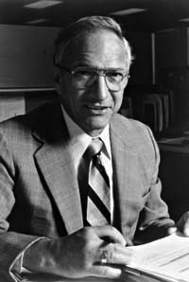
Robert Noyce, 1927-1990
Nicknamed “Mayor of Silicon Valley”
Cofounded Fairchild Semiconductor in 1957
Cofounded Intel in 1968
Co-invented the integrated circuit

Slide 75
Silicon
Transistors built from silicon, a semiconductor
Pure silicon is a poor conductor (no free charges)
Doped silicon is a good conductor (free charges)
  n-type (free negative charges, electrons)
  p-type (free positive charges, holes)

Slide 76
MOS Transistors
Metal oxide silicon (MOS) transistors:
  Polysilicon (used to be metal) gate
  Oxide (silicon dioxide) insulator
  Doped silicon

Slide 77
Transistors: nMOS
Gate = 0
OFF (no connection between source and drain)
Gate = 1
ON (channel between source and drain)

Slide 78
Transistors: pMOS
pMOS transistor is opposite
  ON when Gate = 0
  OFF when Gate = 1

Slide 79
Transistor Function

Slide 80
Transistor Function
nMOS: pass good 0’s, so connect source to GND
pMOS: pass good 1’s, so connect source to V_{DD}

Slide 81
CMOS Gates: NOT Gate
A | P1 | N1 | Y
0
1

Slide 82
CMOS Gates: NOT Gate
A | P1 | N1 | Y
0 | ON | OFF | 1
1 | OFF | ON | 0

Slide 83
CMOS Gates: NAND Gate
A | B | P1 | P2 | N1 | N2 | Y
0 | 0
0 | 1
1 | 0
1 | 1

Slide 84
CMOS Gates: NAND Gate
A | B | P1 | P2 | N1 | N2 | Y
0 | 0 | ON | ON | OFF | OFF | 1
0 | 1 | ON | OFF | OFF | ON | 1
1 | 0 | OFF | ON | ON | OFF | 1
1 | 1 | OFF | OFF | ON | ON | 0

Slide 85
CMOS Gate Structure

Slide 86
NOR Gate
How do you build a three-input NOR gate?

Slide 87
NOR3 Gate

Slide 88
Other CMOS Gates
How do you build a two-input AND gate?

Slide 89
AND2 Gate

Slide 90
Transmission Gates
nMOS pass 1’s poorly
pMOS pass 0’s poorly
Transmission gate is a better switch
  passes both 0 and 1 well
When EN = 1, the switch is ON:
  EN = 0 and A is connected to B
When EN = 0, the switch is OFF:
  A is not connected to B

Slide 91
Pseudo-nMOS Gates
Replace pull-up network with weak pMOS transistor that is always on
pMOS transistor: pulls output HIGH only when nMOS network not pulling it LOW

Slide 92
Pseudo-nMOS Example
Pseudo-nMOS NOR4

Slide 93
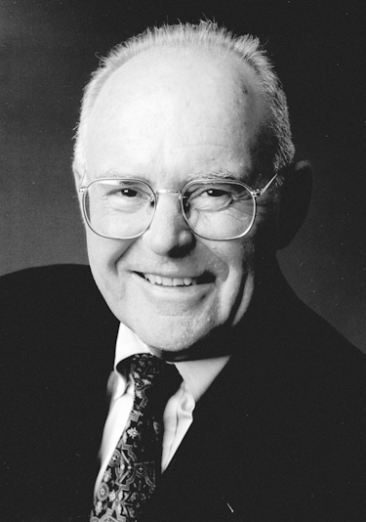
Gordon Moore, 1929-
Cofounded Intel in 1968 with Robert Noyce.
Moore’s Law: number of transistors on a computer chip doubles every year (observed in 1965)
Since 1975, transistor counts have doubled every two years.

Slide 94
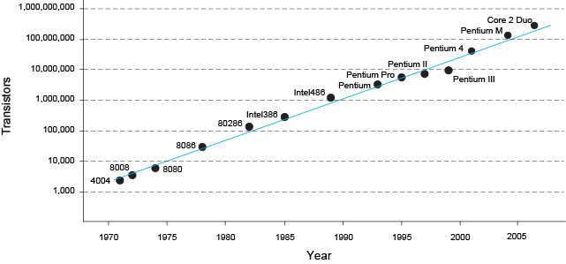
Moore’s Law
“If the automobile had followed the same development cycle as the computer, a Rolls-Royce would today cost $100, get one million miles to the gallon, and explode once a year . . .”
– Robert Cringley

Slide 95
Power Consumption
Power = Energy consumed per unit time
  Dynamic power consumption
  Static power consumption

Slide 96
Dynamic Power Consumption
Power to charge transistor gate capacitances
  Energy required to charge a capacitance, C, to V_{DD} is CV_{DD}²
  Circuit running at frequency f: transistors switch (from 1 to 0 or vice versa) at that frequency
  Capacitor is charged f/2 times per second (discharging from 1 to 0 is free)
Dynamic power consumption:
P_{dynamic} = ½CV_{DD}²f

Slide 97
Static Power Consumption
Power consumed when no gates are switching
Caused by the quiescent supply current, I_{DD} (also called the leakage current)
Static power consumption:
P_{static} = I_{DD}V_{DD}

Slide 98
Power Consumption Example
Estimate the power consumption of a wireless handheld computer
  V_{DD} = 1.2 V
  C = 20 nF
  f = 1 GHz
  I_{DD} = 20 mA

Slide 99
Power Consumption Example
Estimate the power consumption of a wireless handheld computer
  V_{DD} = 1.2 V
  C = 20 nF
  f = 1 GHz
  I_{DD} = 20 mA
P = ½CV_{DD}²f + I_{DD}V_{DD}
= ½(20 nF)(1.2 V)²(1 GHz) +
(20 mA)(1.2 V)
= 14.4 W

