Slide 1
Lecture 4. Instructions
Functionality and usage
Yuri Panchul, 2014

Slide 2
Arithmetic
addu rd, rs, rt
rd = rs + rt
addiu rt, rs, imm - signed 16-bit value
rt = rs + sign_extend (imm)
subu rd, rs, rt
mul rd, rs, rt
mult and div use special registers hi and lo
Explanation about unused add, addi, etc

Slide 3
Synthetic forms of addu
addu rd, rs
A mnemonic for addu rd, rd, rs
addu rt, rs, imm
A mnemonic for addiu rt, rs, imm
addu rt, imm
addiu rt, imm
A mnemonic for addiu rt, rt, imm

Slide 4
Synthetic forms of subu
subu rd, rs
A mnemonic for subu rd, rd, rs
subu rt, rs, imm
A mnemonic for addiu rt, rs, -imm
subu rt, imm
A mnemonic for addiu rt, rt, -imm
negu rd, rs
A mnemonic for subu rd, $0, rs

Slide 5
Bitwise logical
and rd, rs, rt
rd = rs & rt
andi rt, rs, imm - unsigned 16
rd = rs & imm
Similarly or, ori, xor, xori
nor
rd = ~ (rs | rt)
Note there is no nori

Slide 6
Synthetic logical
move rd, rs
Register move
Mnemonics for: or rd, rs, $0

Slide 7
Shifts left
sll rd, rt, shift
rd = rt << shift
sllv rd, rt, rs
rd = rt << rs
Assembler can convert sra mnemonic into srav

Slide 8
Arithmetic and logical shifts right
Arithmetic shift - propagating the sign bit
sra rd, rt, shift
srav rd, rt, rs
Assembler can convert sra mnemonic into srav
Useful to implement signed division by 2^{n}
Logical shift - bringing zeros into high bits
srl rd, rt, shift
srlv rd, rt, rs
Useful to implement unsigned division by 2^{n}

Slide 9
Load constant
lui rt, imm - signed 16-bit value
Load upper immediate
rt = imm << 16
li rd, constant
Synthetic instruction to load immediate constant
la rd, address
Synthetic instruction to load address
Address expression may use labels

Slide 10
Different synthetic forms of li
Form with unsigned 16-bit argument
imm >= 0 && imm < 0x10000 (65536)
ori rd, $0, imm
Form with signed negative 16-bit argument
imm < 0 && imm >= -0xFFFF (-32768)
addiu rd, $0, imm
Form for other 32-bit immediates
lui rd, hi16 (imm); ori rd, rd, lo16 (imm)

Slide 11
Set if...
slt rd, rs, rt
if (signed (rs) < signed (rt)) rd = 1; else rd = 0
slti rd, rs, imm - 16 bit signed immediate
if (signed (rs) < signed (imm)) rd = 1; else rd = 0
sltu and sltiu - use unsigned comparison
Note that in sltiu 16-bit immediate is still sign-extended to 32 bits, then compared using unsigned comparison

Slide 12
Synthetic set if...
seq, sne
set if equal (==), set if not equal (!=)
sge / sgeu
signed / unsigned set if greater than or equal (>=)
sgt / sgtu
signed / unsigned set if greater than (>)
sle / sleu
signed / unsigned set if less than or equal (<=)

Slide 13
Loads and stores
lb rd, address
Load byte, sign-extended
Fill bits [31:8] in MIPS32, [63:8] in MIPS64 with bit 7
lbu rd, address
Load byte, unsigned
Fill bits [31:8] in MIPS32, [63:8] in MIPS64 with 0
lh, lhu
Similarly with 2-byte halfwords

Slide 14
Loads and stores - continue
lw rd, address
Load 4-byte word
sb rd, address
Store byte, signed and unsigned form is unnecessary
sh rd, address
Store 2-byte halfword
sw rd, address
Store 4-byte word

Slide 15
Branches, jumps and calls
PC-relative branches (PC = program counter)
Short range - 256KB - use 16 bit word offset
Use condition
Absolute addressed jumps with constant
Long range - 256MB - uses 26 bit word address
Jump to register - full 32/64 bit in MIPS32/64
Function calls (subroutines/procedures)
All branches, jumps and calls use delay slots

Slide 16
Branches - beq, b, beqz
beq rs, rt, label
if (rs == rt) goto label
Uses 16 bit word offset
Range +/- 128KB
b label
A mnemonic for beq $0, $0, label
beqz rs, label
A mnemonic for beq rs, $0, label

Slide 17
Branches - bgez, bge, bgeu
bgez rs, label
Signed, if (rs >= 0) goto label
Signed comparison obviously
bge rs, rt, label
Synthetic slt at, rs, rt; beq at, $0, label
Signed, if (rs >= rt) goto label
bgeu rs, rt, label
Synthetic sltu at, rs, rt; beq at, $0, label
Unsigned, if (rs >= rt) goto label

Slide 18
Branches - bgtz, bgt, bgtu
bgtz rs, label
Signed, if (rs > 0) goto label
Signed comparison
bgt rs, rt, label
Synthetic slt at, rt, rs; bne at, $0, label
Signed, if (rs > rt) goto label
bgtu rs, rt, label
Synthetic sltu at, rt, rs; bne at, $0, label
Unsigned, if (rs > rt) goto label

Slide 19
Compare bge and bgt
bge rs, rt, label
slt at, rs, rt
beq at, $0, label
if ((rs < rt) == 0) goto label
bgt rs, rt, label
slt at, rt, rs
bne at, $0, label
if ((rt < rs) == 1) goto label

Slide 20
Other branches
Other true machine instruction branches
blez rs, label
Branch if less or equal to zero
bltz rs, label
Branch if less than zero
bne rs, rt, label
Branch if rs not equal to rt
Other synthetic branches
ble, bleu, blt, bltu

Slide 21
Absolute jumps
j label
Absolute addressed jumps with constant
Long range - 256MB
Uses 26 bit word address
Lowest 2 bits assumed to be 0
Highest 4 bits are kept as current PC
jr rs
Jump to address in register
32-bit in MIPS32,64 bit in MIPS64

Slide 22
Function calls - short range
bgezal rs, label
if (rs >= 0) call function
Return address is unconditionally saved in ra ($31)
bltzal rs, label
if (rs < 0) call function
Return address is unconditionally saved in ra ($31)
bal label
Mnemonics for bgezal $0, label

Slide 23
Function calls - long range
jal label
Return address is saved in ra ($31)
jalr rd, rs
Store return address to rd, jump to the contents of rs
jalr rs
Mnemonics for jalr ra, rs

Slide 24
Using stack for function calls
Stack pointer - register sp ($29)
Frame pointer - register fp ($30)
The discussion how to use stack

Slide 25
MIPS64 - compatible with MIPS32
In MIPS64 32-bit operands in 64-bit registers are treated as signed-extended
Instructions like addiu simply continue to work
Operand in load upper immediate (lui rt, imm) is sign-extended
Sign is copied in bits [63:32] of the target register
Additional instructions for 64-bit operands

Slide 26
Additional MIPS64 instructions
daddu, daddiu, dsubu, dmul
dsll, dsllv, dsra, dsrav
Constant shift >32 bit - dsll32, dsra32, dsrl32
ld
lwu
Synthetic dla, dli

Slide 27
Instructions that do nothing
Any instruction that targets $0
nop - mnemonic for sll $0, $0, 0
Convenient because it encodes as 0x00000000
ssnop - sll $0, $0, 1
Special treatment on superscalar processors
Guaranteed to spend at least 1 clock cycle to run

Slide 28
Instructions to discuss later
syscall - causes a system call exception
di and ei - disable and enable interrupts
eret - return from exception
cache - instruction to work with caches
sync - memory access synchronizer

Slide 29
Instructions to discuss later - 2
ll - load linked, for atomic access
sc - store conditional, for atomic access
mfc0 - move from coprocessor 0
mtc0 - move to coprocessor 0
ehb - execution hazard barrier, for coprocessor 0 access

Slide 30
Useful sometimes
clo and clz - count leading ones and zeros
ext and ins - bit manipulation
rol and ror - rotations
seb and seh - sign extension
wsbh - byte swap
MIPS64 additions to all the above
Except seb and seh, they don’t need MIPS64 version

Slide 31
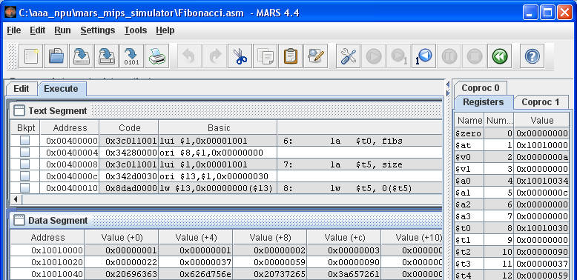
How to practice - MARS simulator

Slide 32
Thank you!

