Slide 1
Lecture 3. Assembly
Syntax and selected directives
Yuri Panchul, 2014

Slide 2
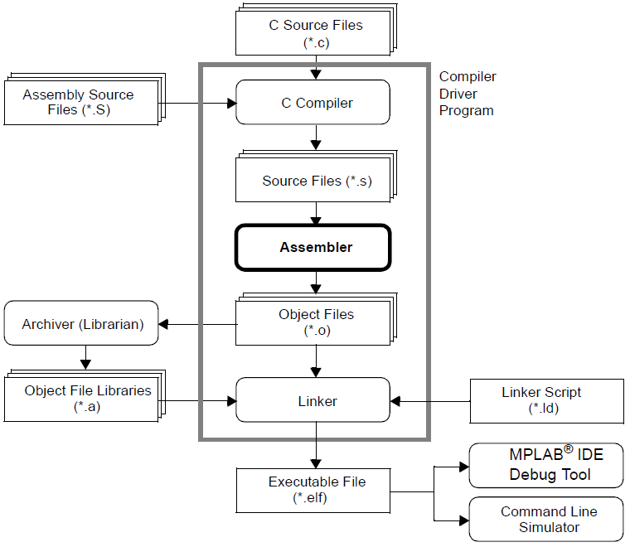
Microchip MPLAB X tools flow
From Microchip Technology MPLAB-ASMLINK32-User-Guide.pdf

Slide 3
Symbols, numbers and expressions
Symbols use letters, digits, underscore ‘_’ and period ‘.’
Symbols may not begin with a digit
Numbers - like in C, but also has binary numbers - 0b01010101
Expressions - like in C
Special symbol “.” for program counter

Slide 4
Local labels for branches
Special case - local labels “0:”, “1:”, … “9:”
Used in branch instructions with suffix “f” (“forward”) and “b” (“backward”)
1: b 1f; nop
2: b 1b; nop
1: b 2b; nop

Slide 5
Directives: Sections
.text - program code section
.data - initialized data section
.rodata - initialized read-only data section
Used to place C const variables: const int a = 3;
.bss - uninitialized data section
Initialized with zeroes by boot code
.sdata - “small data” for use with gp register
.sbss - also for use with gp register

Slide 6
Directives: Initialization
Characters: .ascii “string₁” [, …, “string_{n}”]
Zero-terminated: .asciz “string₁” [, …,“string_{n}”]
Bytes: .byte expr₁ [, …,expr_{n}]
2-byte halfword: .hword expr₁ [, …,expr_{n}]
4-byte word: .word expr₁ [, …,expr_{n}]
8-byte doubleword: .dword expr₁ [, …,expr_{n}]
double float: .double value₁ [, …,value_{n}]

Slide 7
Other data-related directives
.global symbol
.extern symbol [, size]
.align [align [, fill]]
.space size [, fill]

Slide 8
Directives to repeat code sequences
.rept count … .endr
.irp symbol value₁ [, …,value_{n}] … .endr
.irpc symbol value … .endr
.irp reg, 0, 1, 2, 3
lw $\reg, 1024 + \reg * 4 (sp)
.endr

Slide 9
Controlling code generation
.set noat - assembler must not use at ($1) register
.set noreorder - assembler must not move instructions inside branch delay slots
.set nomacro - generate warnings for so-called synthesized instructions that are expanded into multiple machine instructions

Slide 10
Compile-time error directive
.err
.error “string”
They are useful for conditional compilation when preprocessor is used

Slide 11
Special: “Small” memory support
gp - “global pointer”, register $28
gp-relative addressing
A convention to quickly access “global” 64K memory
In addition to accessing memory in “normal” way
Saves 1 instruction to load upper part of the address
Assembly support
.sdata section for grouping “small” memory variables
%gp_rel macro: lw t0, %gp_rel (my_variable) (gp)
.extern should be with size: .extern my_variable, 4

Slide 12
Thank you!

